Slide 1
Academy, Fountain Park, Lewis Place, Vandeventer
Monthly Crime Report: December 2020
Washington University Medical Center

Slide 2
Academy: Summary Notes
13 total crimes in December 2020
-35% change compared to December 2019 (20 total crimes)
5 crime(s) against persons in December 2020
-17% change compared to December 2019 (6 crimes against persons)
190 total crimes in 2020
-15% change compared to this time in 2019 (224 total crimes)
68 crime(s) against persons in 2020
0% change compared to this time in 2019 (68 crimes against persons)

Slide 3
Academy: Year to Year Comparison
2019 | 2019 | 2019 | 2019 | 2019 | 2019 | 2019 | 2019 | 2019 | 2019 | 2019 | 2019 | 2019 | 2019
Part 1 Crimes | Jan | Feb | Mar | Apr | May | Jun | Jul | Aug | Sep | Oct | Nov | Dec | Total
Aggravated Assault | 8 | 7 | 4 | 3 | 2 | 4 | 3 | 5 | 8 | 2 | 0 | 6 | 52
Arson | 0 | 1 | 0 | 0 | 0 | 0 | 1 | 0 | 0 | 4 | 0 | 1 | 7
Burgalry | 5 | 3 | 1 | 2 | 1 | 1 | 3 | 4 | 1 | 3 | 0 | 4 | 28
Homicide | 0 | 0 | 0 | 0 | 0 | 0 | 0 | 1 | 0 | 1 | 0 | 0 | 2
Larceny | 7 | 4 | 5 | 8 | 7 | 8 | 9 | 10 | 11 | 11 | 9 | 6 | 95
Motor Vehicle Theft | 2 | 1 | 0 | 1 | 1 | 4 | 4 | 2 | 1 | 3 | 2 | 3 | 24
Rape | 0 | 0 | 0 | 0 | 0 | 0 | 0 | 0 | 0 | 0 | 0 | 0 | 0
Robbery | 0 | 1 | 2 | 2 | 2 | 0 | 0 | 5 | 2 | 1 | 1 | 0 | 16
Total | 22 | 17 | 12 | 16 | 13 | 17 | 20 | 27 | 23 | 25 | 12 | 20 | 224
2020 | 2020 | 2020 | 2020 | 2020 | 2020 | 2020 | 2020 | 2020 | 2020 | 2020 | 2020 | 2020 | 2020
Part 1 Crimes | Jan | Feb | Mar | Apr | May | Jun | Jul | Aug | Sep | Oct | Nov | Dec | Total
Aggravated Assault | 2 | 2 | 1 | 8 | 5 | 5 | 9 | 3 | 3 | 3 | 1 | 4 | 46.0
Arson | 0 | 0 | 0 | 1 | 0 | 1 | 1 | 0 | 0 | 0 | 0 | 0 | 3.0
Burgalry | 2 | 3 | 0 | 3 | 1 | 2 | 1 | 4 | 1 | 0 | 2 | 1 | 20.0
Homicide | 0 | 0 | 0 | 0 | 0 | 3 | 1 | 1 | 1 | 0 | 0 | 0 | 6.0
Larceny | 2 | 2 | 5 | 3 | 2 | 5 | 3 | 9 | 9 | 6 | 5 | 5 | 56.0
Motor Vehicle Theft | 2 | 1 | 3 | 2 | 2 | 6 | 5 | 4 | 5 | 1 | 4 | 2 | 37.0
Rape | 0 | 0 | 0 | 0 | 0 | 0 | 0 | 0 | 0 | 0 | 0 | 0 | 0.0
Robbery | 1 | 0 | 4 | 2 | 1 | 1 | 2 | 4 | 2 | 3 | 1 | 1 | 22.0
Total | 9 | 8 | 13 | 19 | 11 | 23 | 22 | 25 | 21 | 13 | 13 | 13 | 190.0

Slide 4
Academy: Summary Tables
Day of the Week | Number of Crimes
Sun | 3
Mon | 0
Tue | 0
Wed | 2
Thu | 1
Fri | 2
Sat | 5
Total | 13
Part 1 Crimes | Number of Crimes
Aggravated Assault | 4
Burgalry | 1
Larceny | 5
Motor Vehicle Theft | 2
Robbery | 1
Total | 13
Crimes Against Persons | Number of Crimes
FALSE | 8
TRUE | 5
Total | 13
Time of Day | Number of Crimes
Day | 12
Night | 1
Total | 13

Slide 5
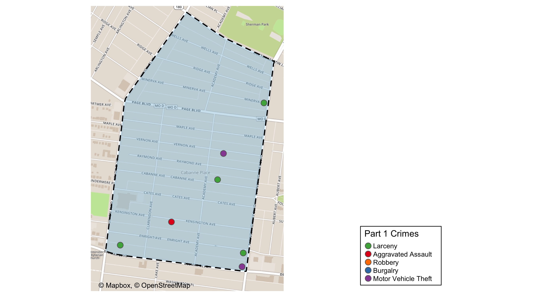
Academy: Total Crime Map

Slide 6
Fountain Park: Summary Notes
7 total crimes in December 2020
133% change compared to December 2019 (3 total crimes)
1 crime(s) against persons in December 2020
0% change compared to December 2019 (1 crimes against persons)
160 total crimes in 2020
-2% change compared to this time in 2019 (163 total crimes)
62 crime(s) against persons in 2020
-7% change compared to this time in 2019 (67 crimes against persons)

Slide 7
Fountain Park: Year to Year Comparison
2019 | 2019 | 2019 | 2019 | 2019 | 2019 | 2019 | 2019 | 2019 | 2019 | 2019 | 2019 | 2019 | 2019
Part 1 Crimes | Jan | Feb | Mar | Apr | May | Jun | Jul | Aug | Sep | Oct | Nov | Dec | Total
Aggravated Assault | 5 | 3 | 11 | 3 | 0 | 3 | 8 | 3 | 7 | 5 | 3 | 0 | 51
Arson | 0 | 0 | 0 | 1 | 0 | 0 | 0 | 1 | 0 | 0 | 0 | 0 | 2
Burgalry | 3 | 2 | 1 | 0 | 2 | 0 | 2 | 2 | 2 | 0 | 3 | 1 | 18
Homicide | 0 | 1 | 1 | 0 | 0 | 0 | 1 | 0 | 0 | 1 | 0 | 0 | 4
Larceny | 4 | 5 | 6 | 5 | 2 | 5 | 6 | 7 | 10 | 3 | 3 | 1 | 57
Motor Vehicle Theft | 3 | 0 | 4 | 1 | 0 | 2 | 2 | 0 | 2 | 1 | 0 | 0 | 15
Rape | 0 | 0 | 0 | 0 | 0 | 0 | 0 | 0 | 0 | 0 | 0 | 0 | 0
Robbery | 1 | 0 | 0 | 2 | 0 | 3 | 1 | 5 | 0 | 2 | 1 | 1 | 16
Total | 16 | 11 | 23 | 12 | 4 | 13 | 20 | 18 | 21 | 12 | 10 | 3 | 163
2020 | 2020 | 2020 | 2020 | 2020 | 2020 | 2020 | 2020 | 2020 | 2020 | 2020 | 2020 | 2020 | 2020
Part 1 Crimes | Jan | Feb | Mar | Apr | May | Jun | Jul | Aug | Sep | Oct | Nov | Dec | Total
Aggravated Assault | 2 | 3 | 2 | 3 | 4 | 11 | 6 | 4 | 10 | 1 | 6 | 1 | 53.0
Arson | 0 | 0 | 1 | 0 | 0 | 1 | 0 | 0 | 0 | 0 | 0 | 0 | 2.0
Burgalry | 0 | 0 | 3 | 1 | 3 | 6 | 1 | 1 | 1 | 2 | 0 | 0 | 18.0
Homicide | 1 | 0 | 0 | 0 | 0 | 0 | 2 | 0 | 0 | 0 | 1 | 0 | 4.0
Larceny | 4 | 5 | 3 | 4 | 7 | 8 | 4 | 4 | 4 | 6 | 2 | 5 | 56.0
Motor Vehicle Theft | 0 | 3 | 0 | 0 | 0 | 2 | 0 | 4 | 3 | 1 | 2 | 1 | 16.0
Rape | 0 | 0 | 1 | 0 | 0 | 0 | 0 | 0 | 0 | 1 | 0 | 0 | 2.0
Robbery | 1 | 0 | 0 | 0 | 1 | 1 | 0 | 1 | 3 | 0 | 2 | 0 | 9.0
Total | 8 | 11 | 10 | 8 | 15 | 29 | 13 | 14 | 21 | 11 | 13 | 7 | 160.0

Slide 8
Fountain Park: Summary Tables
Day of the Week | Number of Crimes
Sun | 0
Mon | 0
Tue | 1
Wed | 3
Thu | 1
Fri | 0
Sat | 2
Total | 7
Part 1 Crimes | Number of Crimes
Aggravated Assault | 1
Larceny | 5
Motor Vehicle Theft | 1
Total | 7
Crimes Against Persons | Number of Crimes
FALSE | 6
TRUE | 1
Total | 7
Time of Day | Number of Crimes
Day | 6
Night | 1
Total | 7

Slide 9
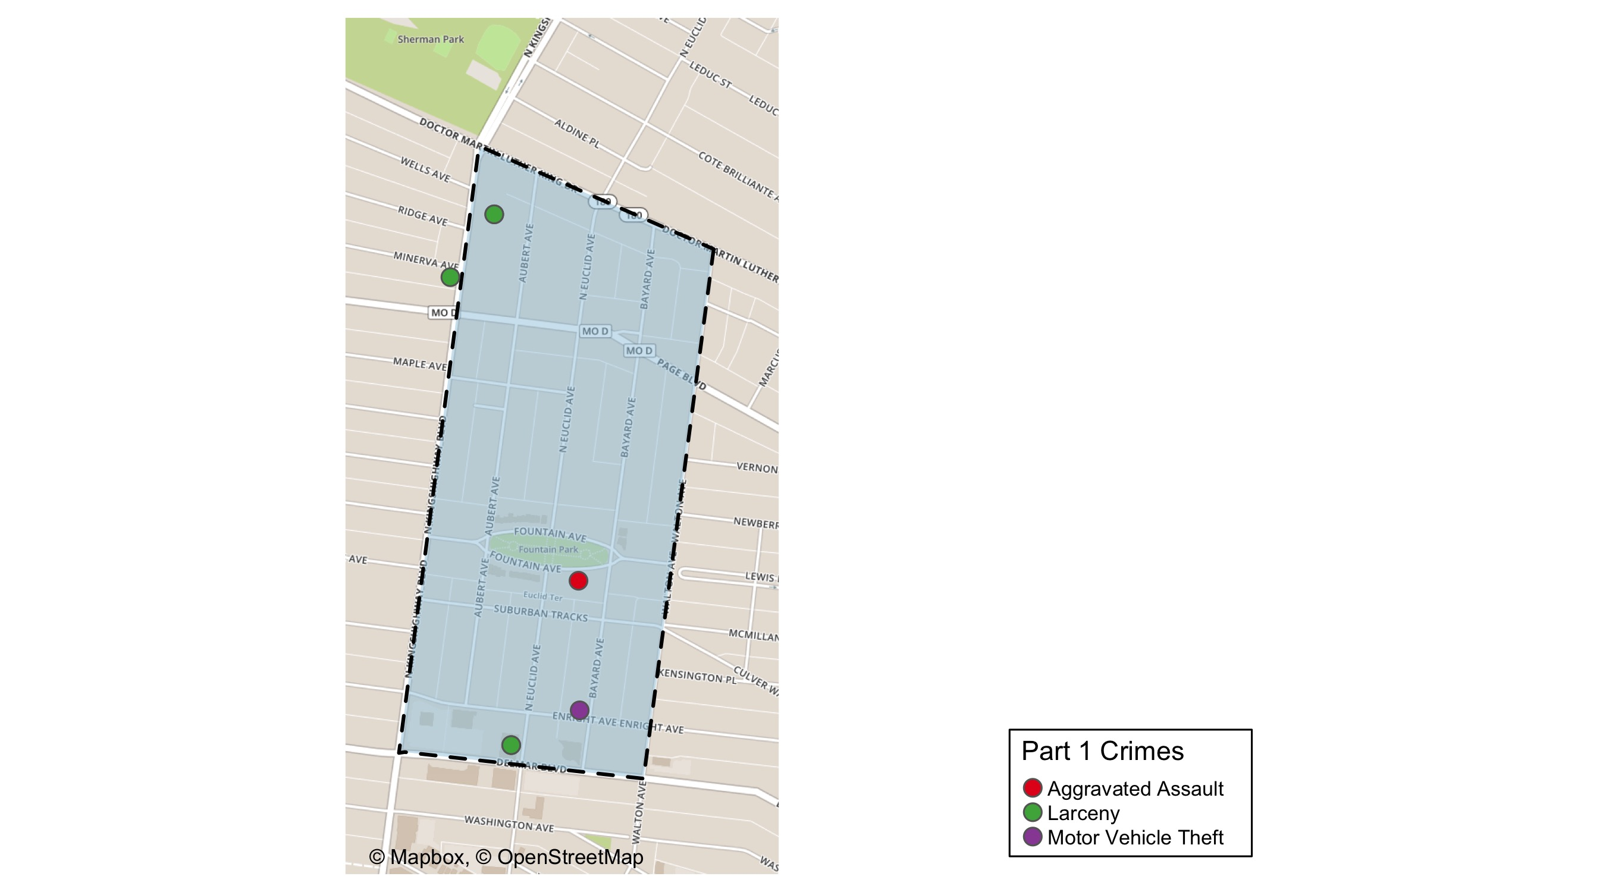
Fountain Park: Total Crime Map

Slide 10
Lewis Place: Summary Notes
5 total crimes in December 2020
-67% change compared to December 2019 (15 total crimes)
0 crime(s) against persons in December 2020
-100% change compared to December 2019 (7 crimes against persons)
94 total crimes in 2020
-26% change compared to this time in 2019 (127 total crimes)
38 crime(s) against persons in 2020
-14% change compared to this time in 2019 (44 crimes against persons)

Slide 11
Lewis Place: Year to Year Comparison
2019 | 2019 | 2019 | 2019 | 2019 | 2019 | 2019 | 2019 | 2019 | 2019 | 2019 | 2019 | 2019 | 2019
Part 1 Crimes | Jan | Feb | Mar | Apr | May | Jun | Jul | Aug | Sep | Oct | Nov | Dec | Total
Aggravated Assault | 0 | 3 | 2 | 3 | 13 | 1 | 2 | 0 | 5 | 4 | 0 | 6 | 39
Arson | 0 | 1 | 0 | 0 | 1 | 0 | 0 | 0 | 0 | 0 | 0 | 0 | 2
Burgalry | 0 | 1 | 0 | 1 | 0 | 1 | 2 | 4 | 0 | 2 | 4 | 1 | 16
Homicide | 0 | 0 | 1 | 1 | 2 | 0 | 3 | 0 | 0 | 0 | 0 | 0 | 7
Larceny | 5 | 2 | 3 | 6 | 3 | 5 | 4 | 2 | 2 | 5 | 0 | 4 | 41
Motor Vehicle Theft | 0 | 1 | 2 | 1 | 1 | 1 | 0 | 1 | 5 | 1 | 1 | 3 | 17
Rape | 0 | 0 | 0 | 0 | 0 | 0 | 0 | 0 | 0 | 0 | 0 | 0 | 0
Robbery | 0 | 0 | 0 | 0 | 1 | 0 | 1 | 1 | 1 | 0 | 0 | 1 | 5
Total | 5 | 8 | 8 | 12 | 21 | 8 | 12 | 8 | 13 | 12 | 5 | 15 | 127
2020 | 2020 | 2020 | 2020 | 2020 | 2020 | 2020 | 2020 | 2020 | 2020 | 2020 | 2020 | 2020 | 2020
Part 1 Crimes | Jan | Feb | Mar | Apr | May | Jun | Jul | Aug | Sep | Oct | Nov | Dec | Total
Aggravated Assault | 0 | 4 | 6 | 1 | 0 | 3 | 3 | 2 | 6 | 3 | 2 | 0 | 30.0
Arson | 0 | 0 | 1 | 0 | 0 | 0 | 1 | 0 | 1 | 0 | 0 | 0 | 3.0
Burgalry | 0 | 1 | 1 | 0 | 0 | 1 | 1 | 0 | 0 | 0 | 2 | 0 | 6.0
Homicide | 1 | 0 | 0 | 0 | 1 | 0 | 0 | 1 | 0 | 0 | 1 | 1 | 5.0
Larceny | 3 | 1 | 2 | 1 | 3 | 2 | 2 | 5 | 5 | 1 | 0 | 3 | 28.0
Motor Vehicle Theft | 2 | 2 | 0 | 3 | 0 | 2 | 2 | 0 | 1 | 0 | 0 | 1 | 13.0
Rape | 0 | 1 | 0 | 0 | 0 | 0 | 0 | 0 | 0 | 0 | 0 | 0 | 1.0
Robbery | 0 | 1 | 3 | 0 | 1 | 1 | 1 | 0 | 0 | 1 | 0 | 0 | 8.0
Total | 6 | 10 | 13 | 5 | 5 | 9 | 10 | 8 | 13 | 5 | 5 | 5 | 94.0

Slide 12
Lewis Place: Summary Tables
Day of the Week | Number of Crimes
Sun | 2
Mon | 0
Tue | 1
Wed | 1
Thu | 1
Fri | 0
Sat | 0
Total | 5
Part 1 Crimes | Number of Crimes
Homicide | 1
Larceny | 3
Motor Vehicle Theft | 1
Total | 5
Crimes Against Persons | Number of Crimes
FALSE | 4
TRUE | 1
Total | 5
Time of Day | Number of Crimes
Day | 4
Night | 1
Total | 5

Slide 13
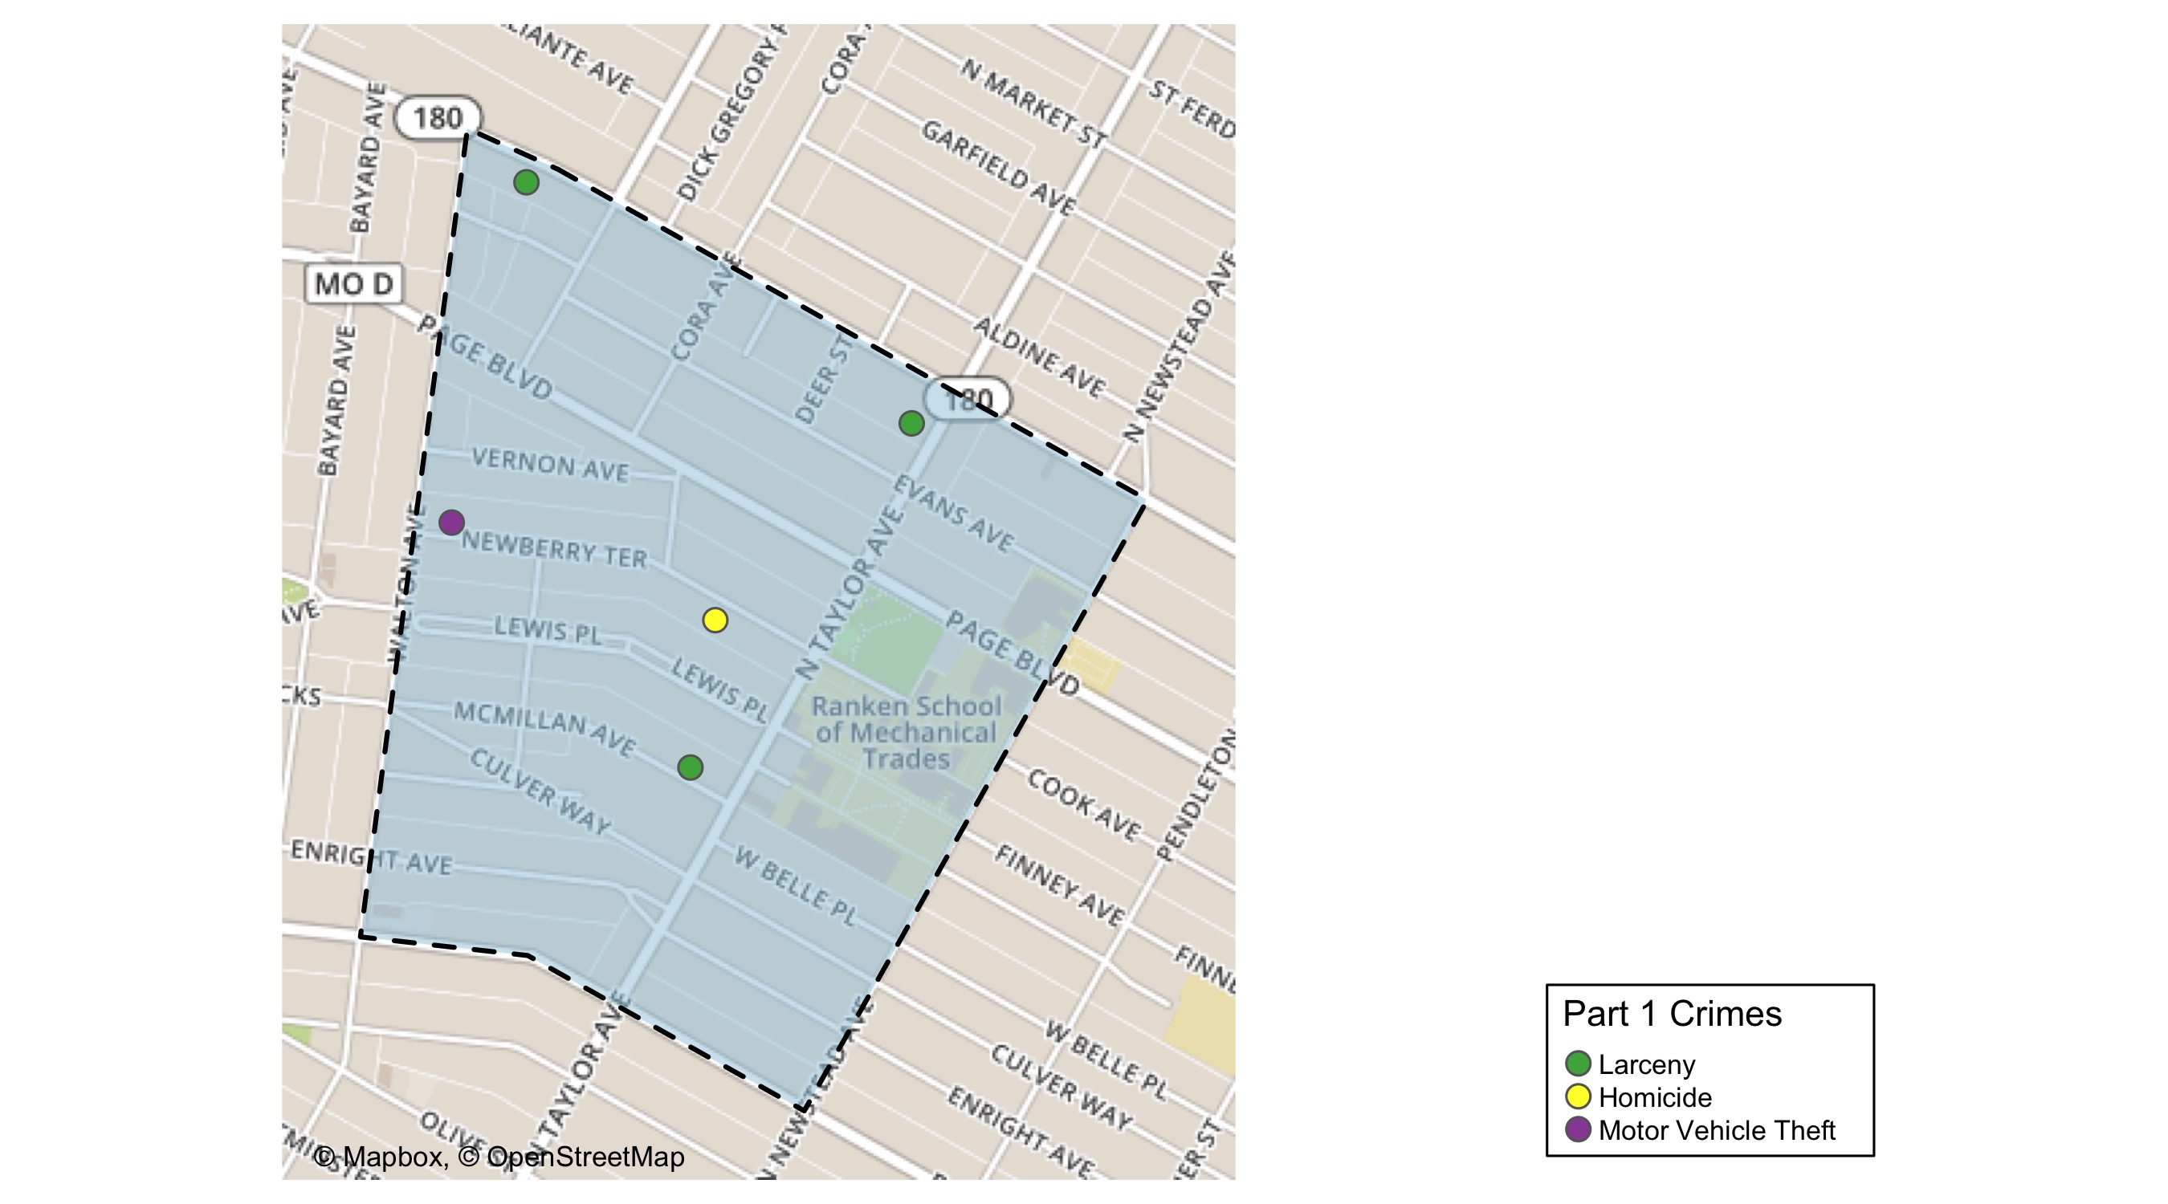
Lewis Place: Total Crime Map

Slide 14
Vandeventer: Summary Notes
9 total crimes in December 2020
-25% change compared to December 2019 (12 total crimes)
4 crime(s) against persons in December 2020
33% change compared to December 2019 (3 crimes against persons)
137 total crimes in 2020
-22% change compared to this time in 2019 (175 total crimes)
50 crime(s) against persons in 2020
43% change compared to this time in 2019 (35 crimes against persons)

Slide 15
Vandeventer: Year to Year Comparison
2019 | 2019 | 2019 | 2019 | 2019 | 2019 | 2019 | 2019 | 2019 | 2019 | 2019 | 2019 | 2019 | 2019
Part 1 Crimes | Jan | Feb | Mar | Apr | May | Jun | Jul | Aug | Sep | Oct | Nov | Dec | Total
Aggravated Assault | 0 | 2 | 6 | 2 | 4 | 0 | 1 | 3 | 1 | 3 | 0 | 2 | 24
Arson | 0 | 1 | 0 | 0 | 0 | 0 | 0 | 0 | 0 | 0 | 0 | 0 | 1
Burgalry | 1 | 2 | 5 | 3 | 5 | 4 | 3 | 1 | 2 | 3 | 5 | 2 | 36
Homicide | 0 | 0 | 1 | 0 | 0 | 0 | 0 | 0 | 0 | 0 | 0 | 0 | 1
Larceny | 5 | 2 | 3 | 5 | 4 | 5 | 14 | 13 | 17 | 6 | 9 | 7 | 90
Motor Vehicle Theft | 0 | 2 | 1 | 0 | 0 | 2 | 1 | 3 | 1 | 1 | 1 | 0 | 12
Rape | 0 | 0 | 0 | 0 | 0 | 0 | 0 | 0 | 0 | 0 | 0 | 0 | 0
Robbery | 0 | 0 | 1 | 0 | 1 | 4 | 0 | 0 | 1 | 2 | 1 | 1 | 11
Total | 6 | 9 | 17 | 10 | 14 | 15 | 19 | 20 | 22 | 15 | 16 | 12 | 175
2020 | 2020 | 2020 | 2020 | 2020 | 2020 | 2020 | 2020 | 2020 | 2020 | 2020 | 2020 | 2020 | 2020
Part 1 Crimes | Jan | Feb | Mar | Apr | May | Jun | Jul | Aug | Sep | Oct | Nov | Dec | Total
Aggravated Assault | 0 | 5 | 5 | 1 | 3 | 2 | 3 | 4 | 3 | 12 | 0 | 3 | 41.0
Arson | 0 | 0 | 0 | 0 | 0 | 0 | 0 | 0 | 0 | 0 | 0 | 0 | 0.0
Burgalry | 2 | 2 | 0 | 2 | 2 | 1 | 0 | 1 | 1 | 1 | 0 | 1 | 13.0
Homicide | 0 | 0 | 0 | 0 | 1 | 1 | 1 | 0 | 0 | 1 | 0 | 0 | 4.0
Larceny | 9 | 1 | 8 | 6 | 3 | 8 | 2 | 5 | 2 | 2 | 2 | 4 | 52.0
Motor Vehicle Theft | 2 | 1 | 2 | 1 | 3 | 1 | 3 | 0 | 2 | 0 | 1 | 0 | 16.0
Rape | 2 | 0 | 0 | 0 | 0 | 0 | 0 | 0 | 0 | 0 | 0 | 0 | 2.0
Robbery | 1 | 1 | 1 | 1 | 1 | 0 | 0 | 2 | 0 | 1 | 0 | 1 | 9.0
Total | 16 | 10 | 16 | 11 | 13 | 13 | 9 | 12 | 8 | 17 | 3 | 9 | 137.0

Slide 16
Vandeventer: Summary Tables
Day of the Week | Number of Crimes
Sun | 1
Mon | 0
Tue | 0
Wed | 1
Thu | 3
Fri | 2
Sat | 2
Total | 9
Part 1 Crimes | Number of Crimes
Aggravated Assault | 3
Burgalry | 1
Larceny | 4
Robbery | 1
Total | 9
Crimes Against Persons | Number of Crimes
FALSE | 5
TRUE | 4
Total | 9
Time of Day | Number of Crimes
Day | 8
Night | 1
Total | 9

Slide 17
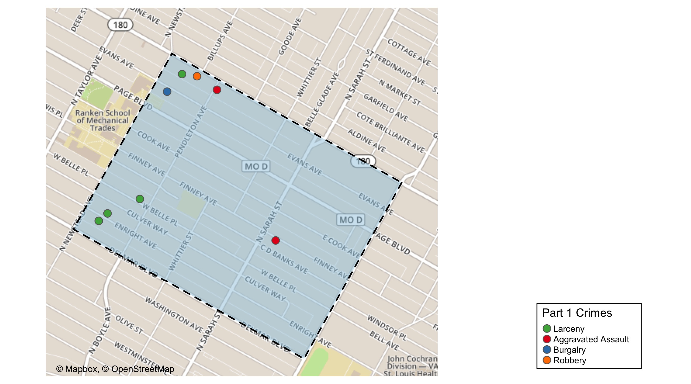
Vandeventer: Total Crime Map

Slide 18
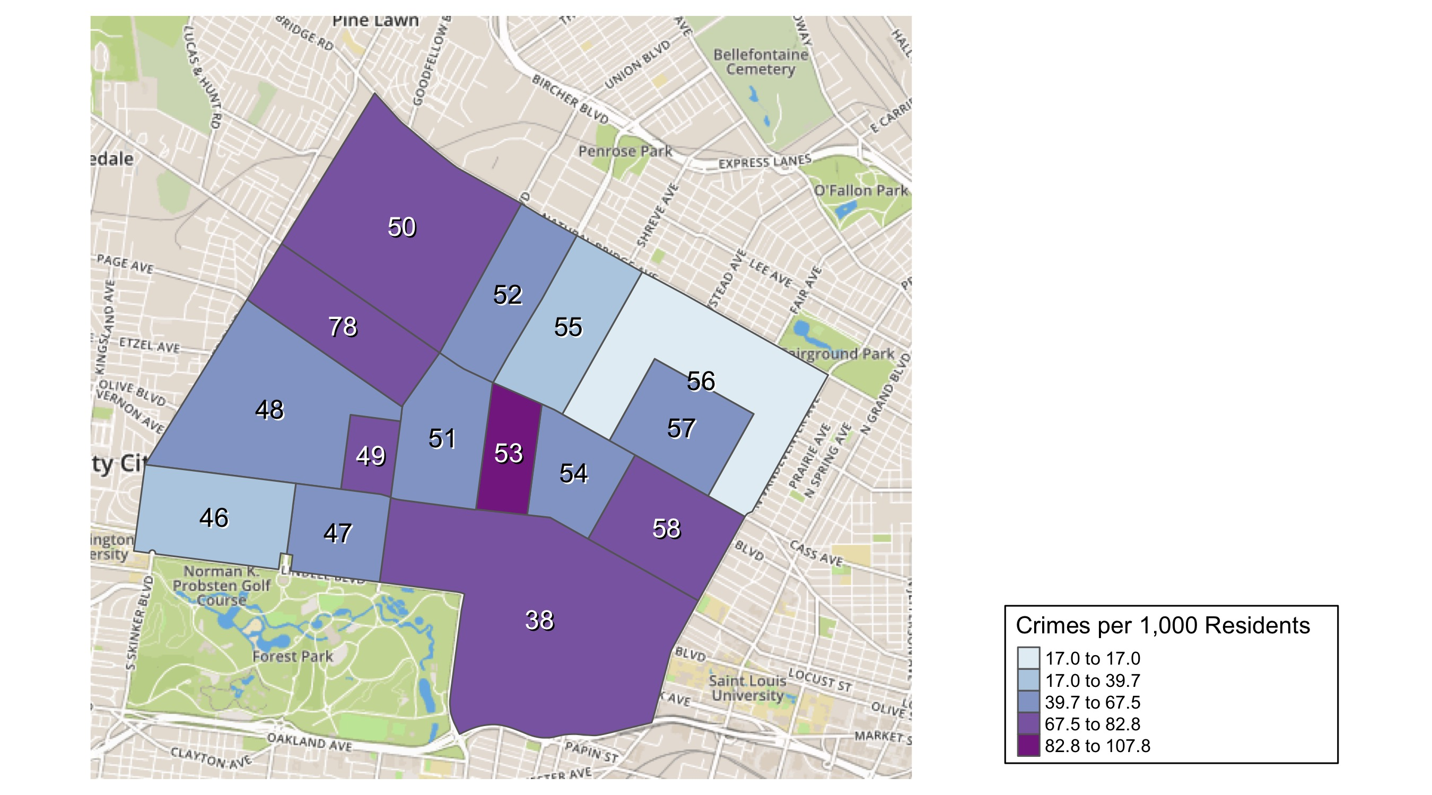
District 5: Crime Rates Map

Slide 19
District 5: Density Map Explanation
There are 15 neighborhoods in District 5
The minimum number of crimes in one neighborhood was 76 (Visitation Park)
The maximum number of crimes in one neighborhood was 1186 (Central West End)
The mean number of crimes in one neighborhood was 257.27
The minimum rate of crimes in one neighborhood was 16.97 (Greater Ville)
The maximum rate of crimes in one neighborhood was 107.82 (Fountain Park)
The mean rate of crimes in one neighborhood was 64.22

Slide 20
Academy: Neighborhood Detail
Appendix 1

Slide 21
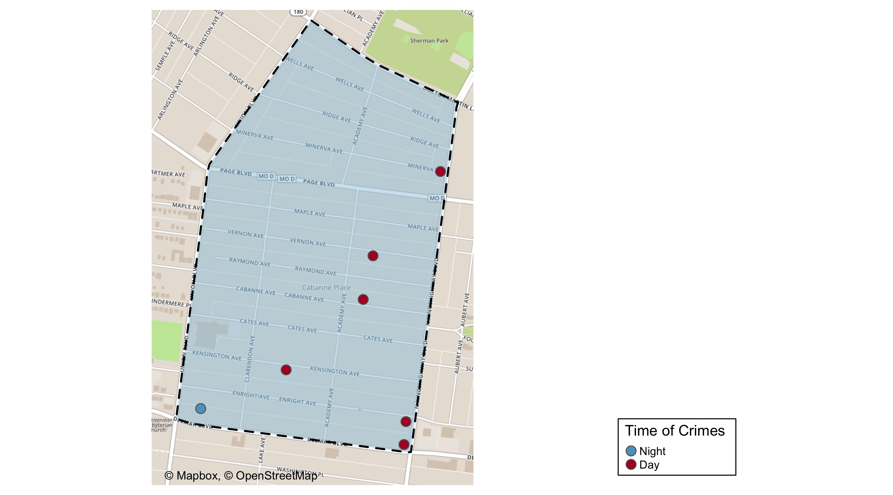
Academy: Time of Crimes Map

Slide 22
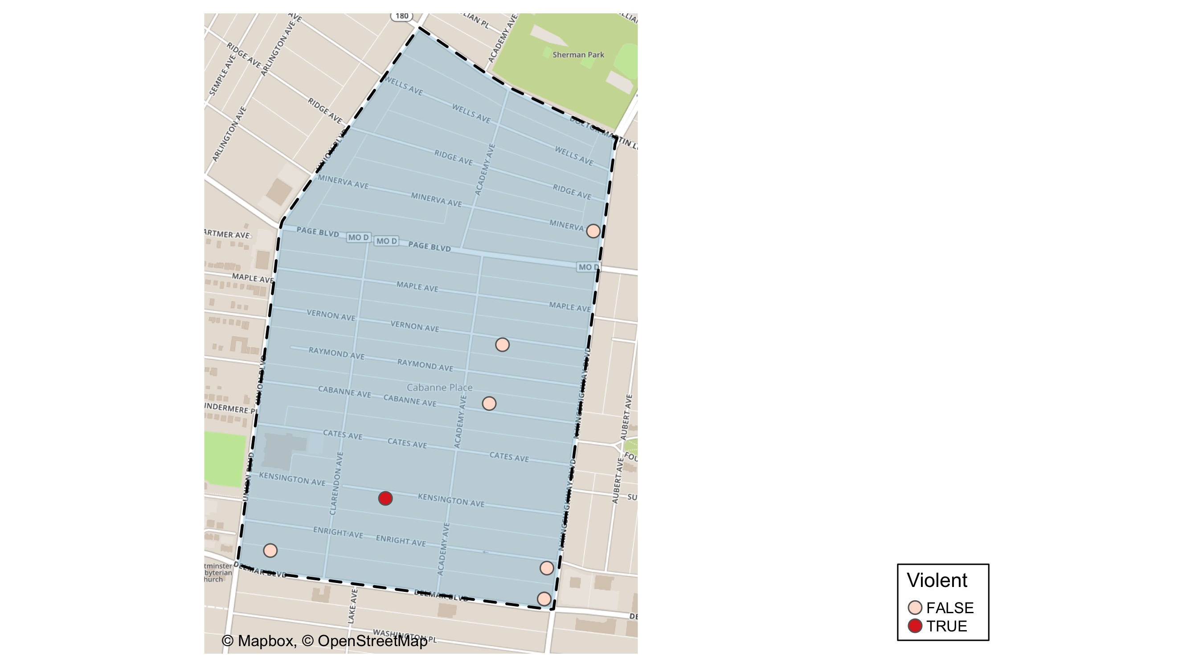
Academy: Violent Crime Map

Slide 23
Academy: Larceny Breakdown
Day of the Week | Number of Crimes
Sun | 1
Wed | 1
Thu | 1
Fri | 2
Total | 5
Type of Larceny | Number of Crimes
All Other | 1
From Motor Vehicle | 1
Motor Vehicle Parts | 1
Shoplifting | 2
Total | 5
Time of Day | Number of Crimes
Day | 4
Night | 1
Total | 5
Monetary | Number of Crimes
Under $500 | 5
Total | 5

Slide 24
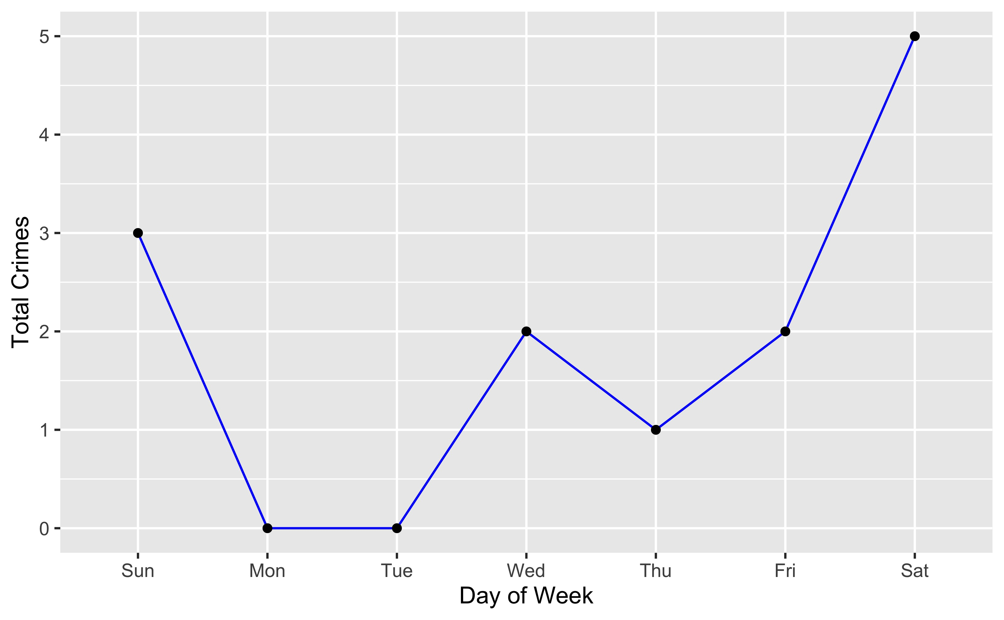
Academy: Total Crimes by Days of the Week

Slide 25
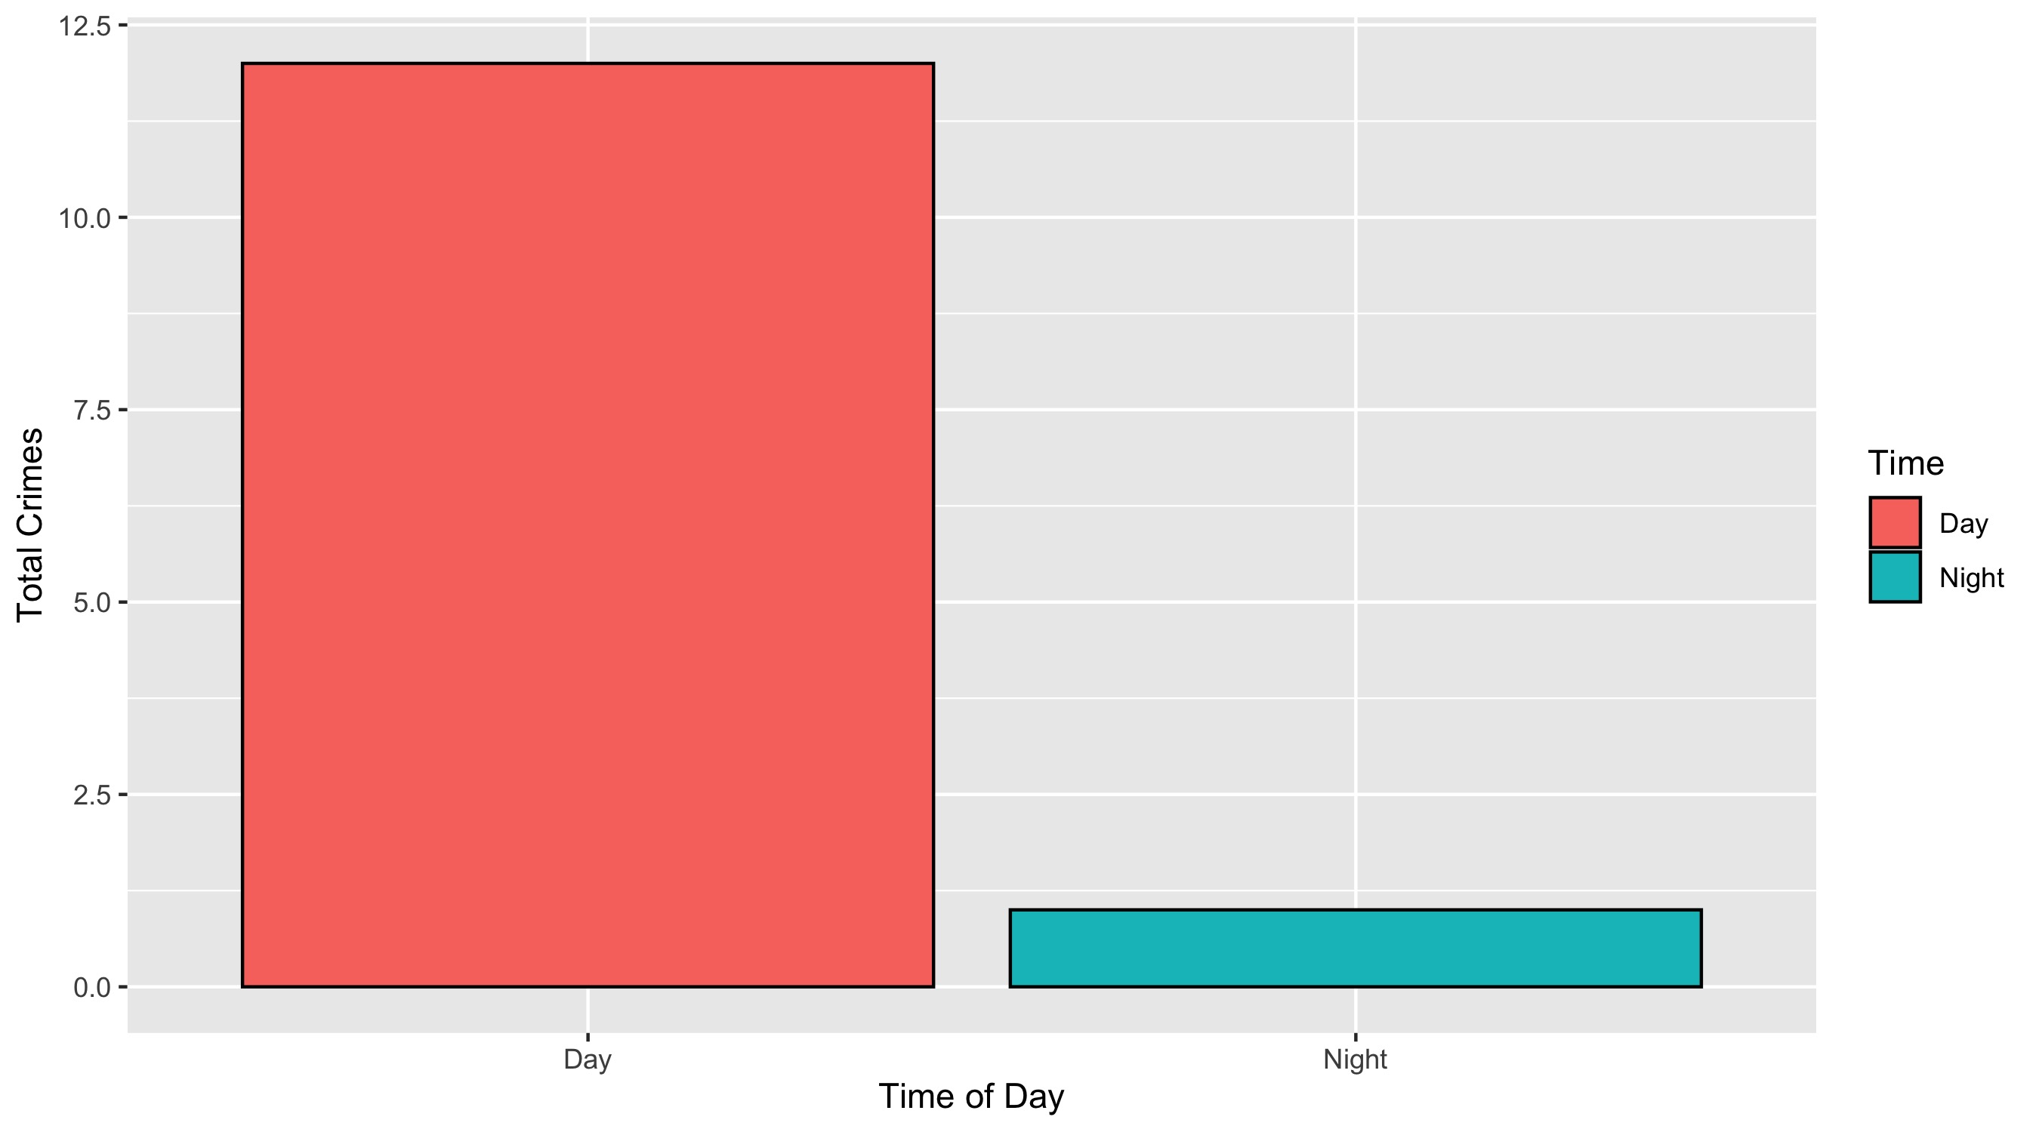
Academy: Crimes by Time of Day

Slide 26
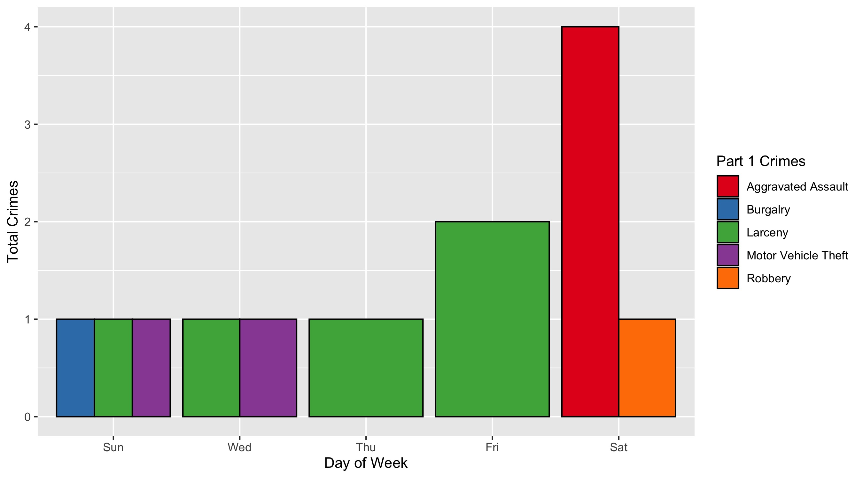
Academy: Crimes by Day and Category

Slide 27
Fountain Park: Neighborhood Detail
Appendix 2

Slide 28
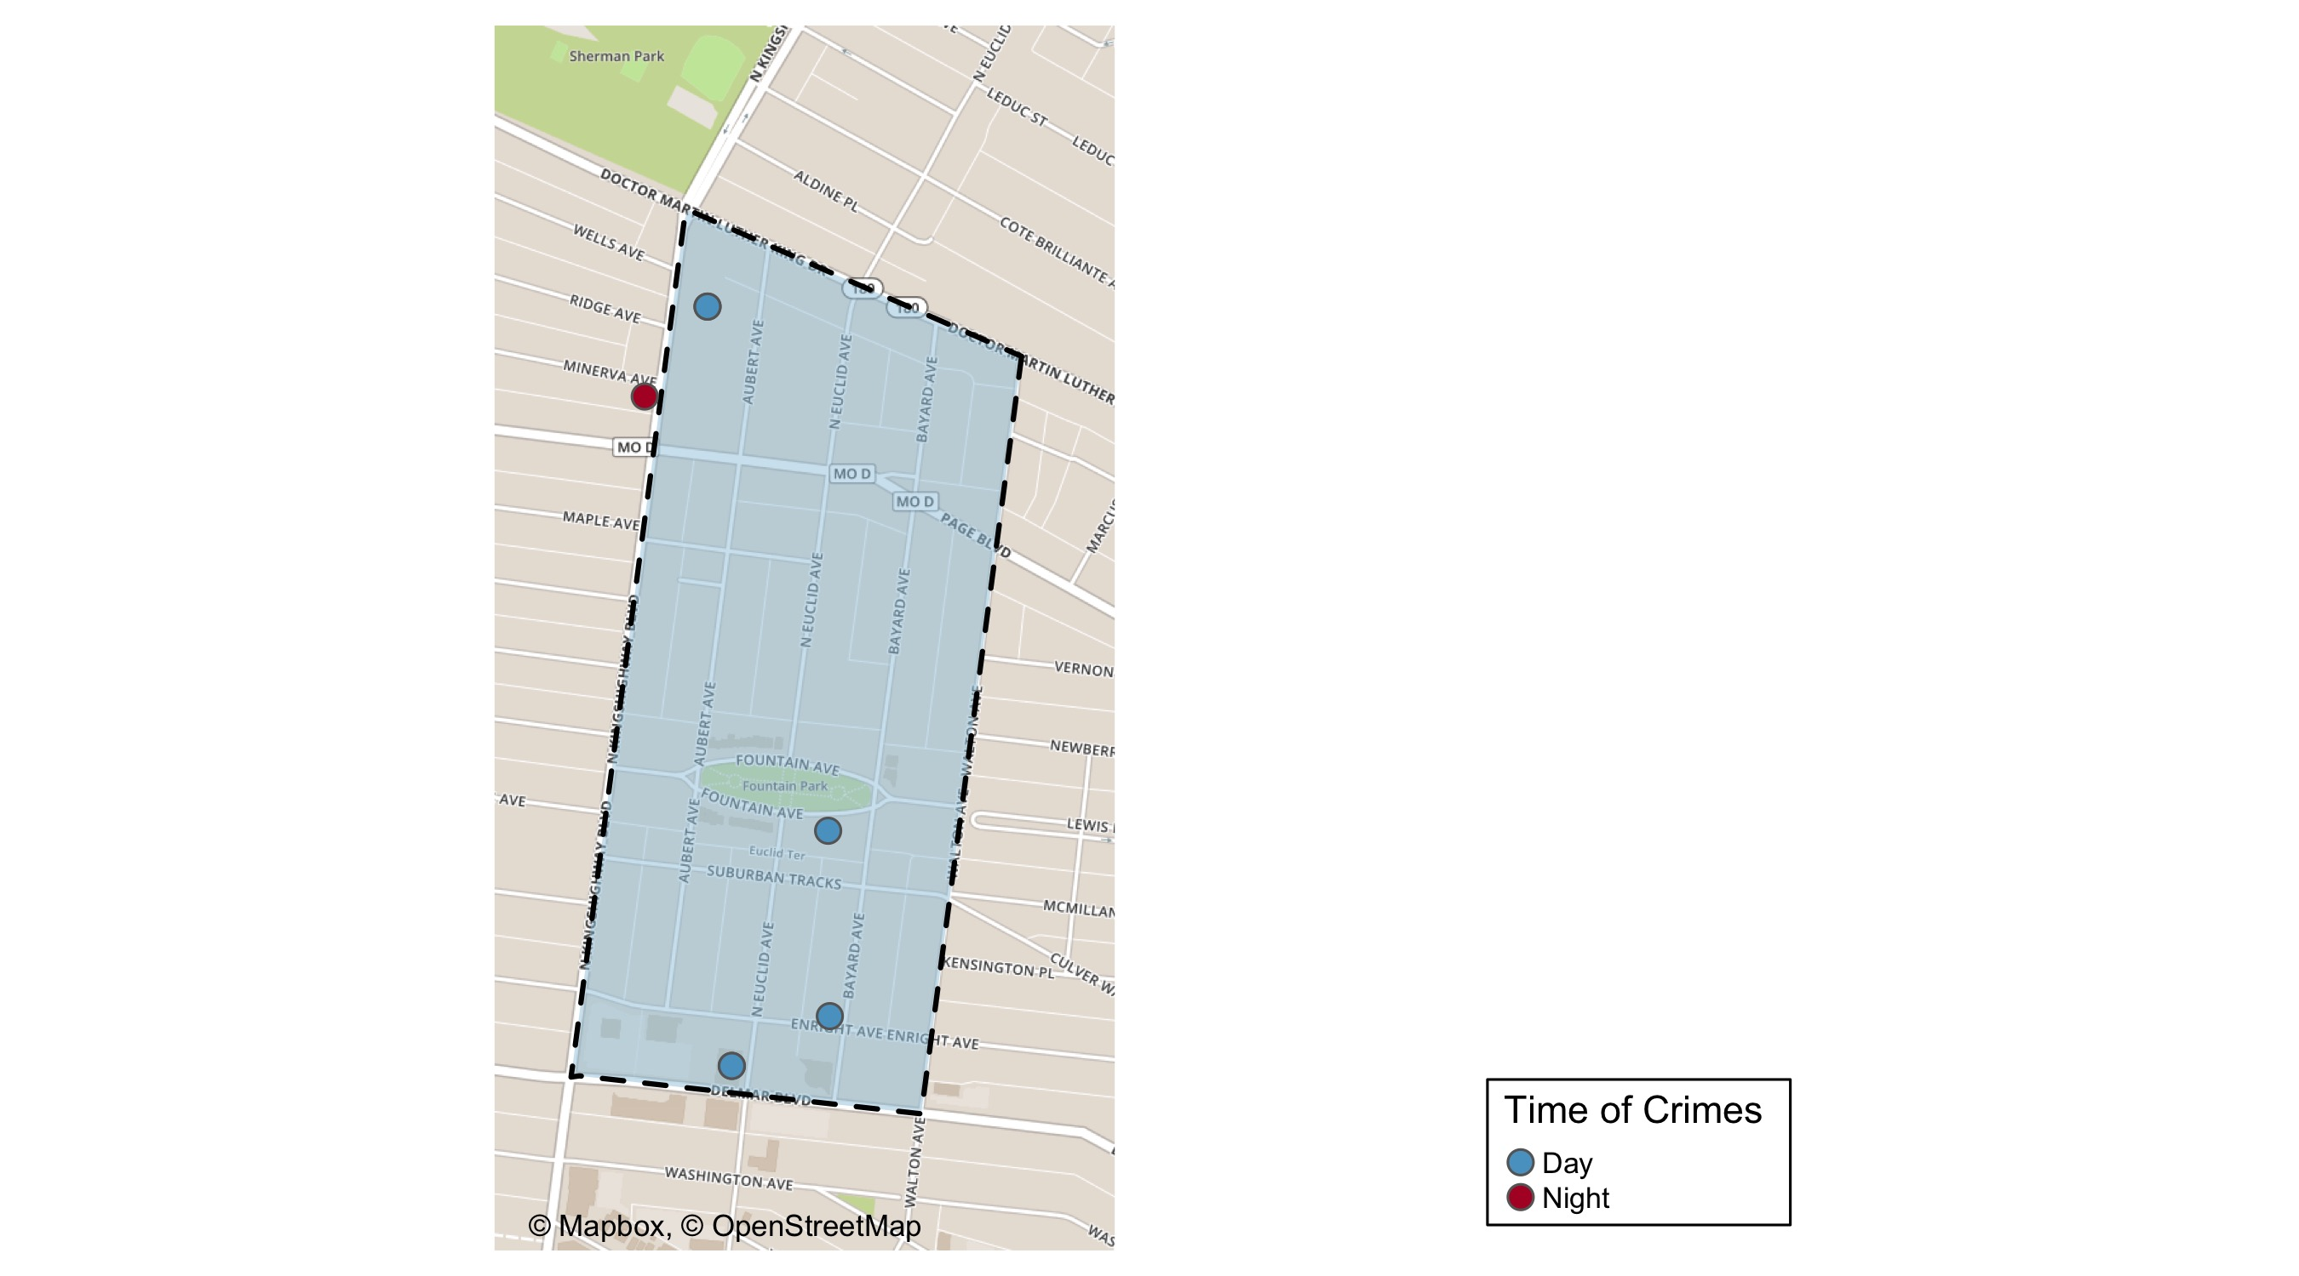
Fountain Park: Time of Crimes Map

Slide 29
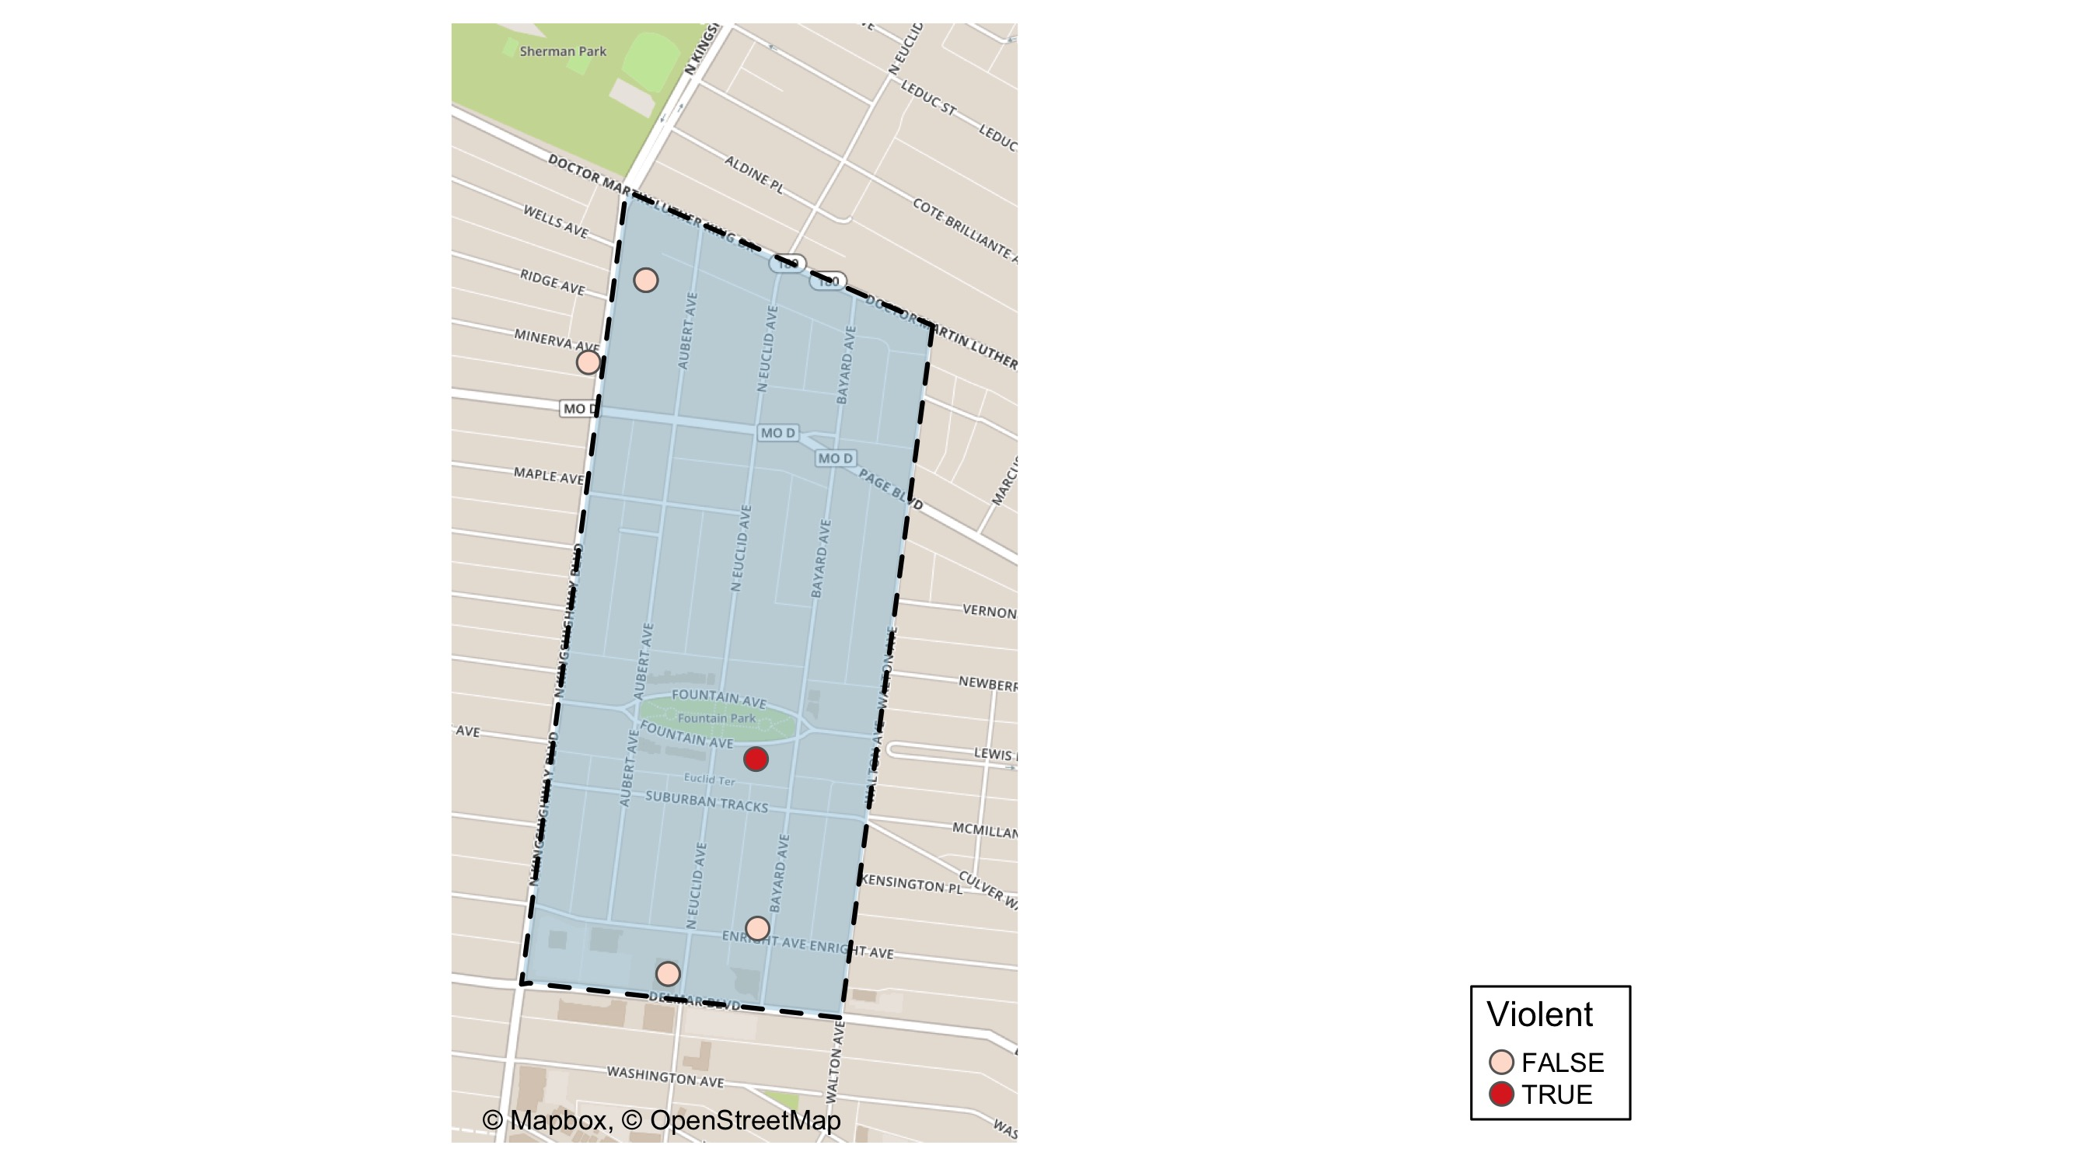
Fountain Park: Violent Crime Map

Slide 30
Fountain Park: Larceny Breakdown
Day of the Week | Number of Crimes
Tue | 1
Wed | 2
Thu | 1
Sat | 1
Total | 5
Type of Larceny | Number of Crimes
All Other | 1
From Building | 1
From Motor Vehicle | 1
From Person | 1
Motor Vehicle Parts | 1
Total | 5
Time of Day | Number of Crimes
Day | 4
Night | 1
Total | 5
Monetary | Number of Crimes
$500 - $24,999 | 2
Under $500 | 3
Total | 5

Slide 31
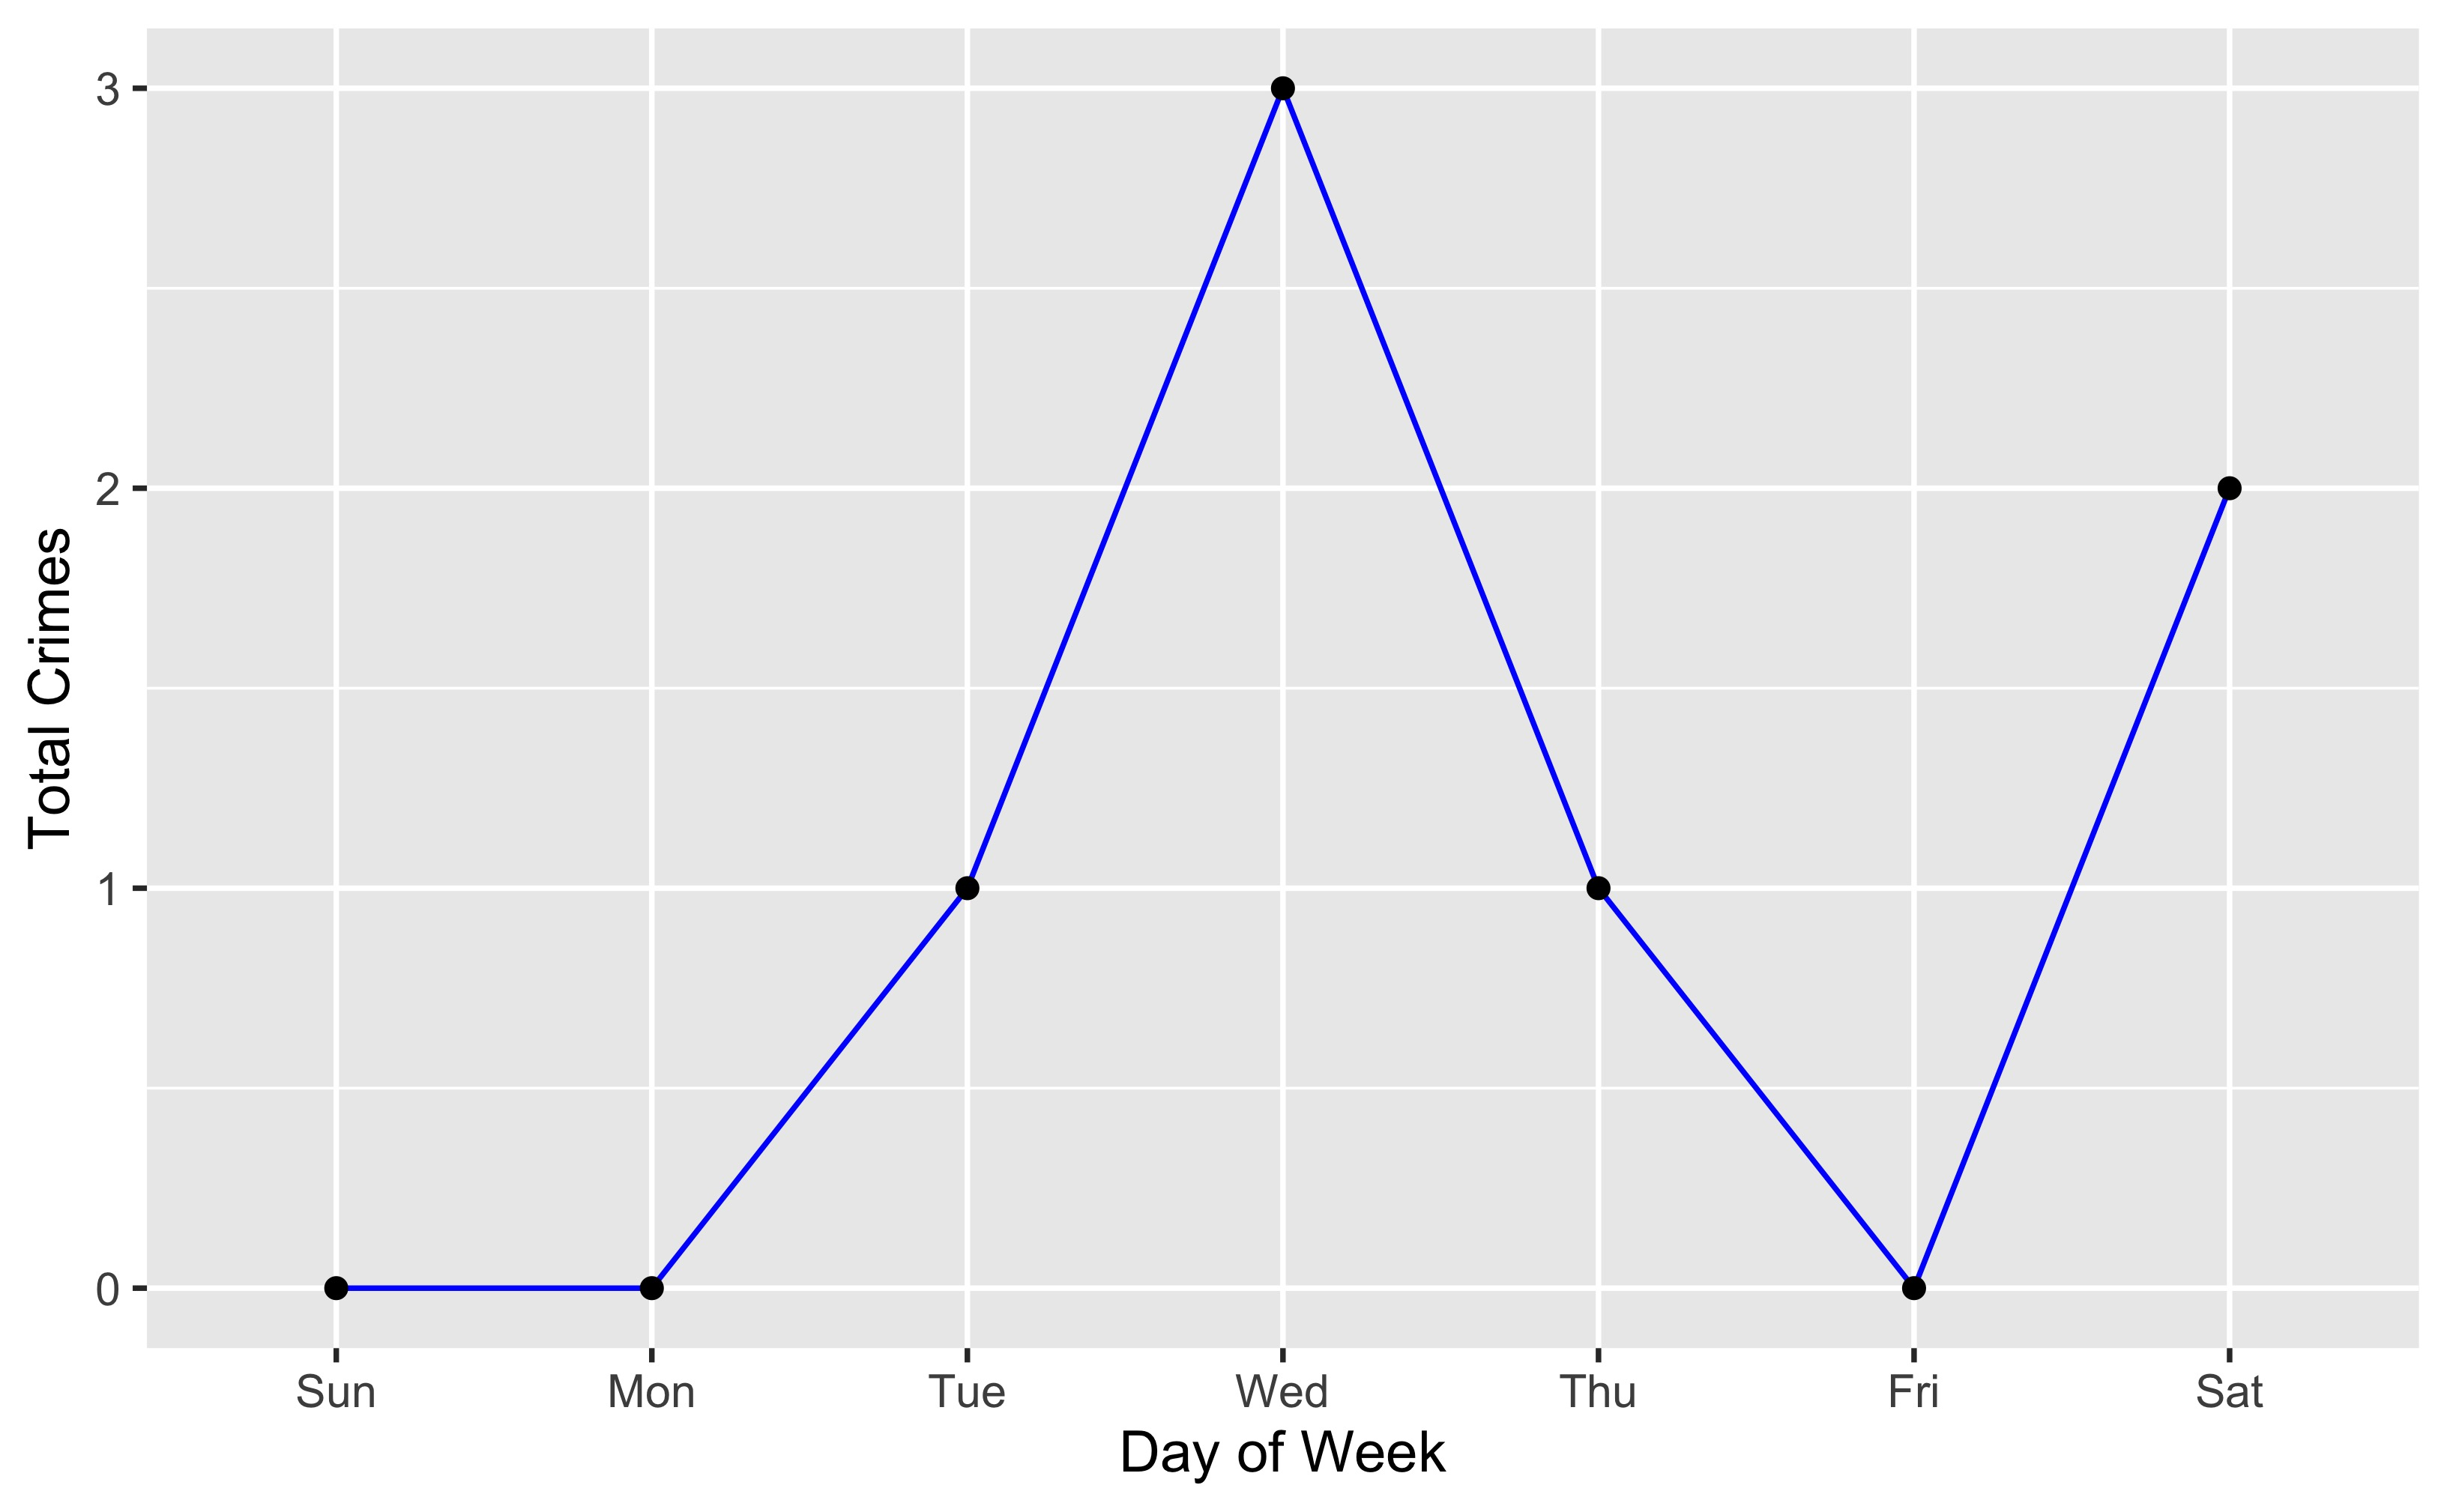
Fountain Park: Total Crimes by Days of the Week

Slide 32
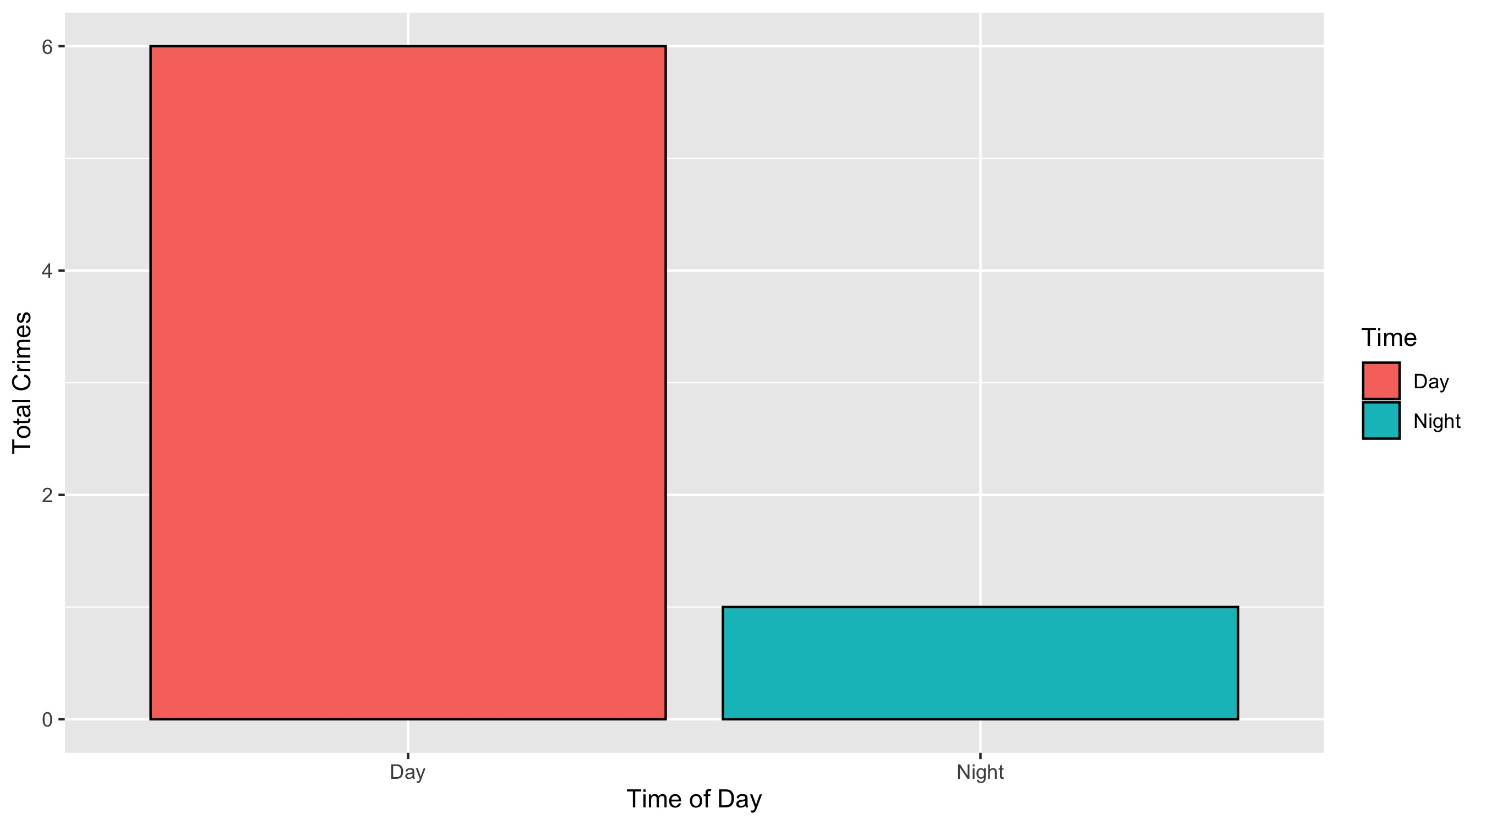
Fountain Park: Crimes by Time of Day

Slide 33
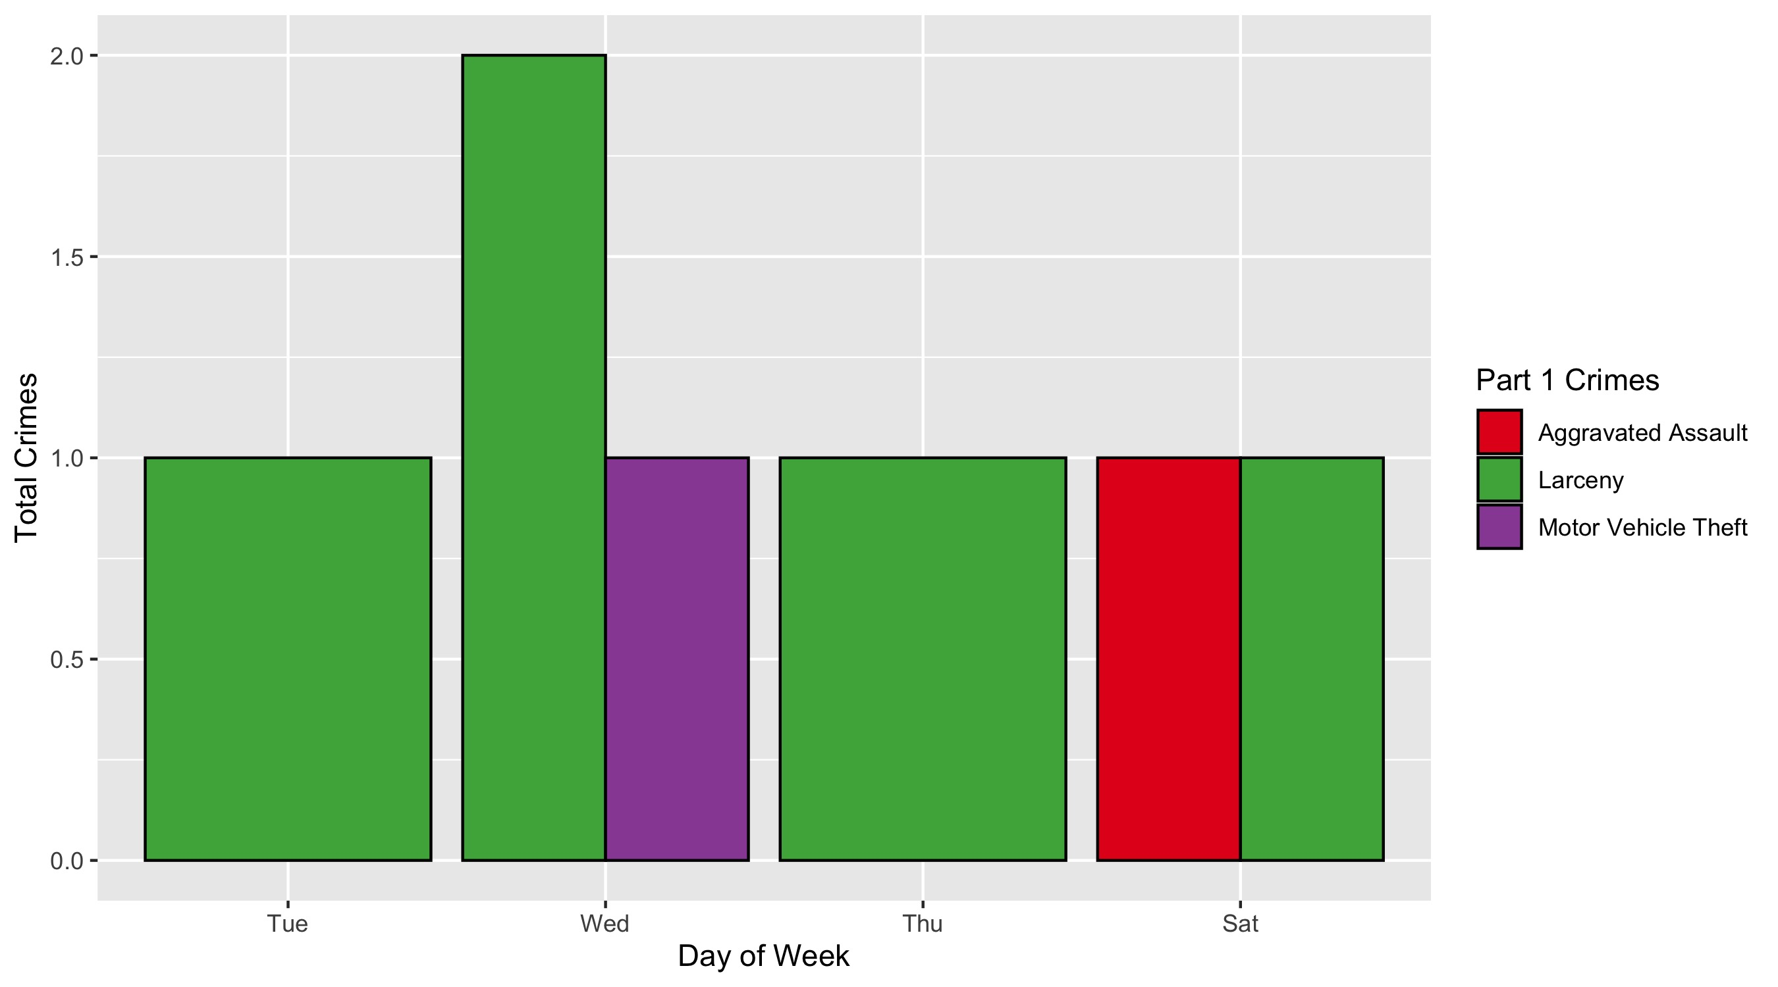
Fountain Park: Crimes by Day and Category

Slide 34
Lewis Place: Neighborhood Detail
Appendix 3

Slide 35
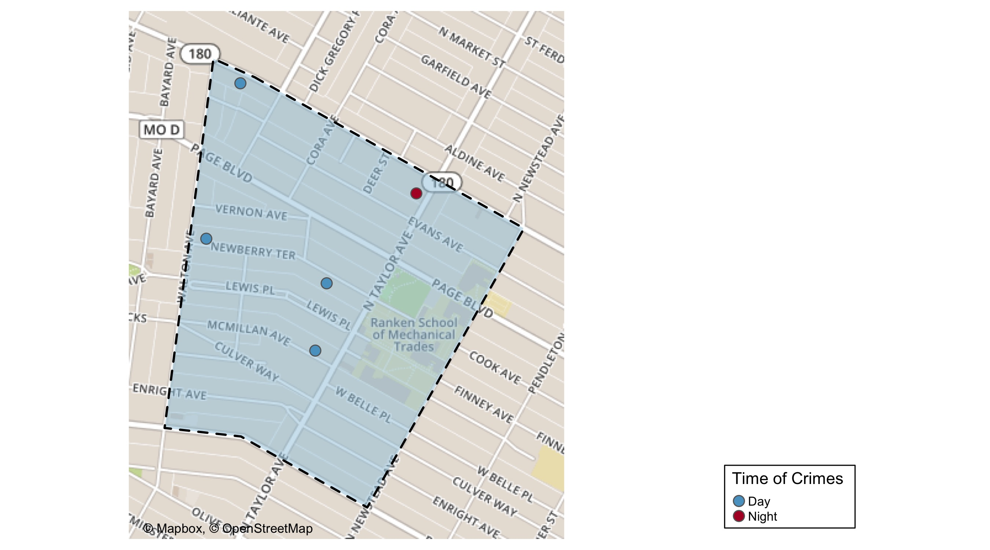
Lewis Place: Time of Crimes Map

Slide 36
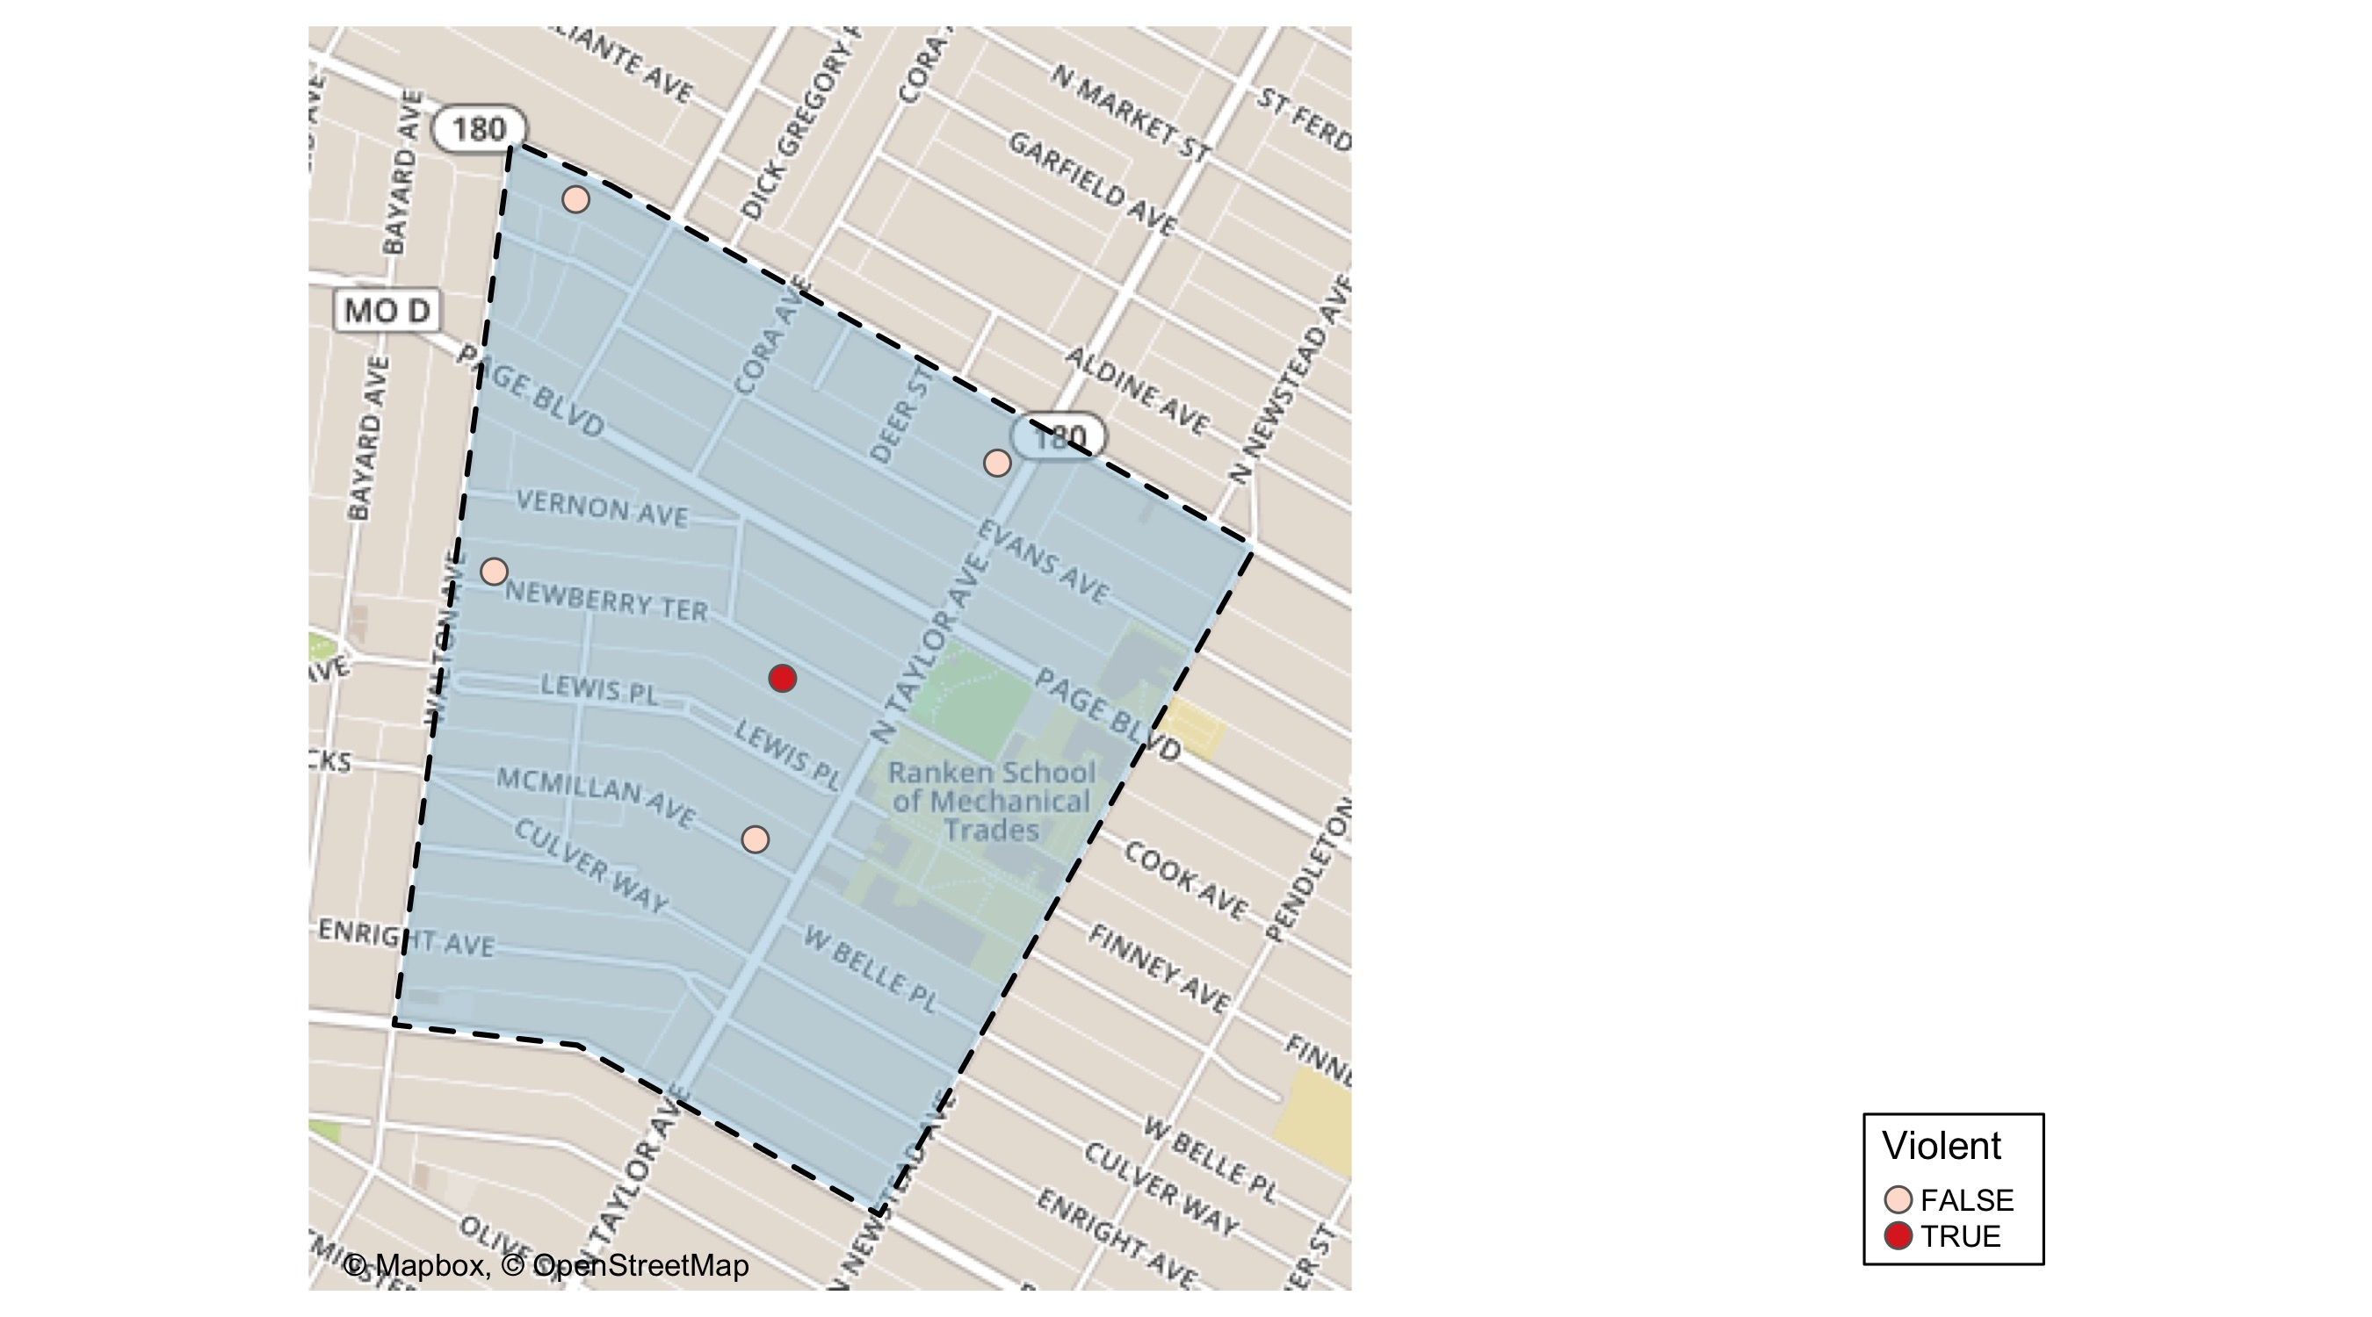
Lewis Place: Violent Crime Map

Slide 37
Lewis Place: Larceny Breakdown
Day of the Week | Number of Crimes
Sun | 1
Tue | 1
Wed | 1
Total | 3
Type of Larceny | Number of Crimes
All Other | 2
From Motor Vehicle | 1
Total | 3
Time of Day | Number of Crimes
Day | 2
Night | 1
Total | 3
Monetary | Number of Crimes
$500 - $24,999 | 1
Under $500 | 2
Total | 3

Slide 38
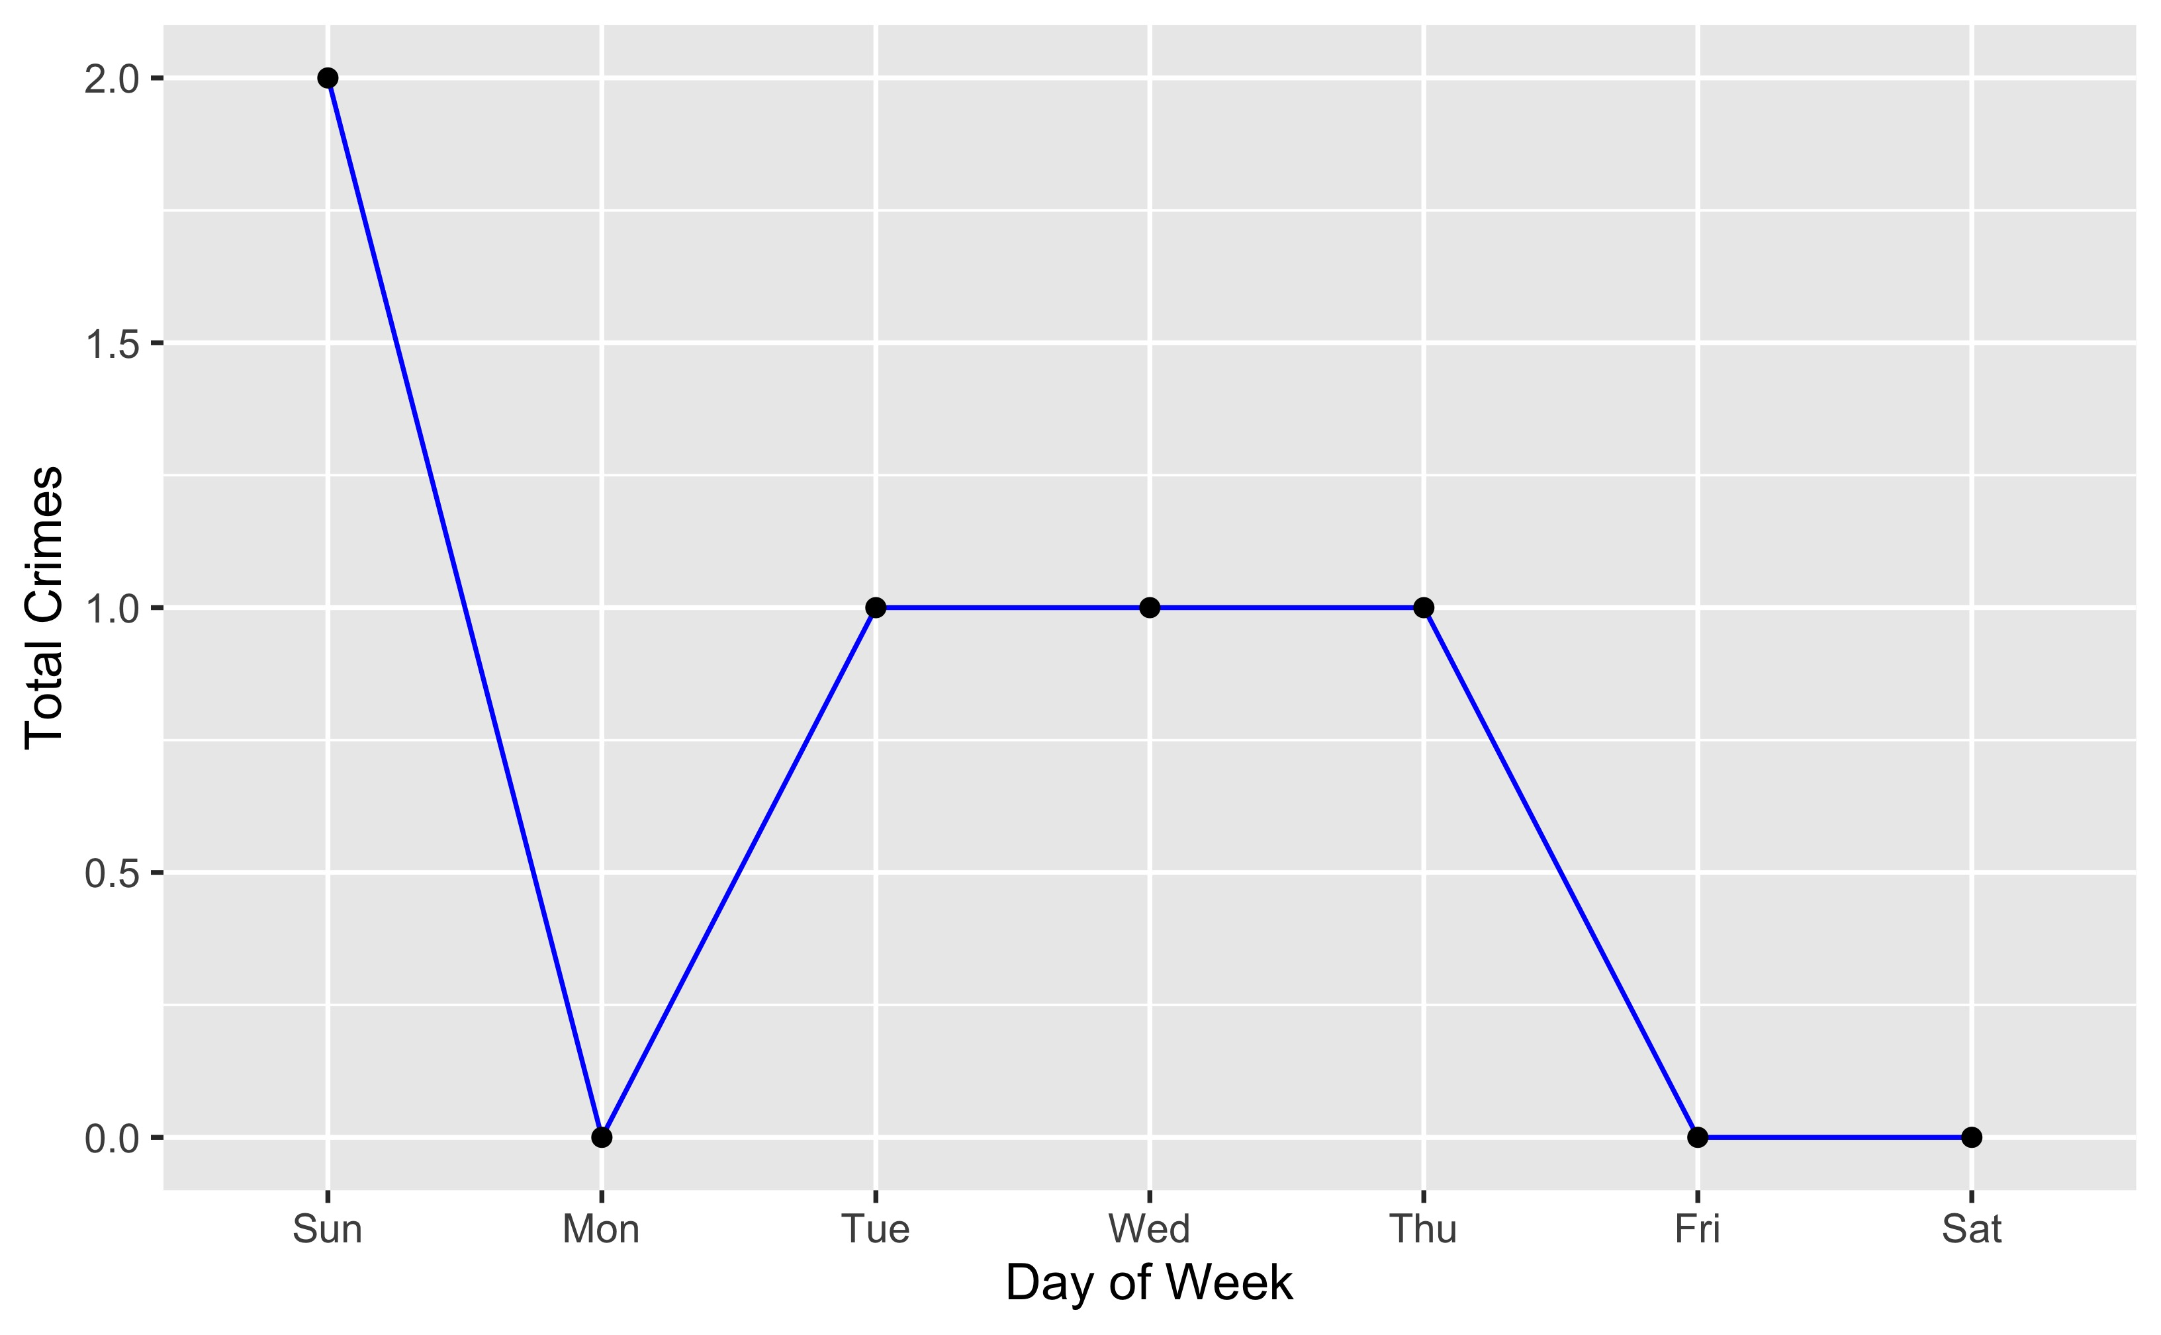
Lewis Place: Total Crimes by Days of the Week

Slide 39
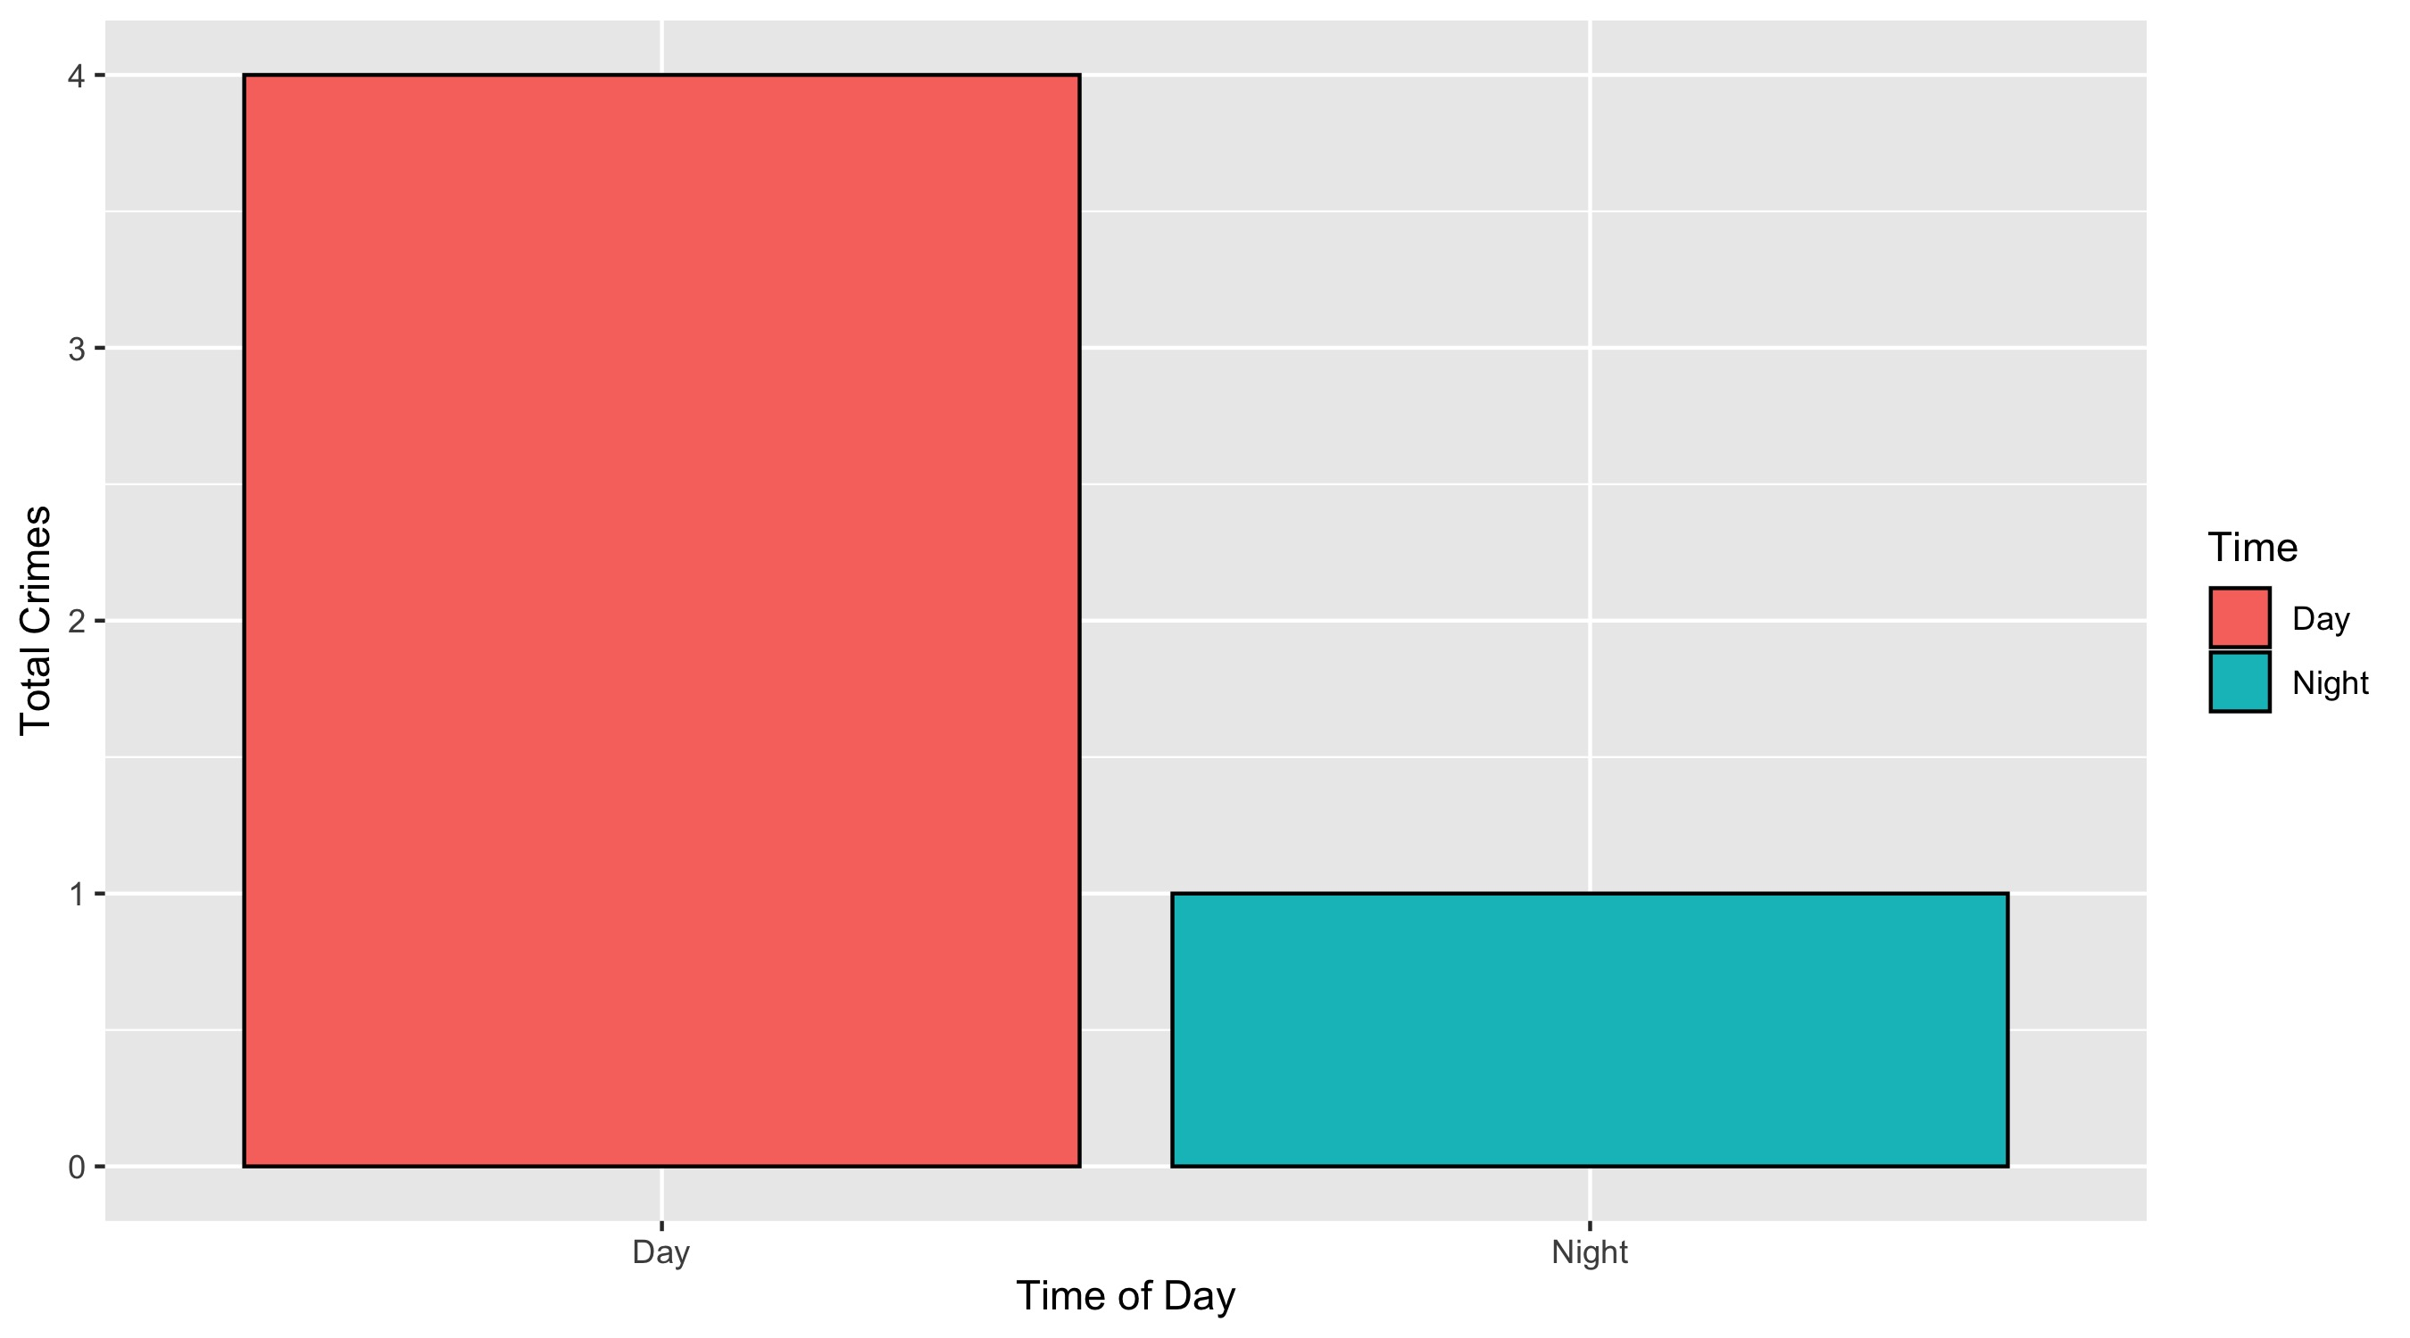
Lewis Place: Crimes by Time of Day

Slide 40
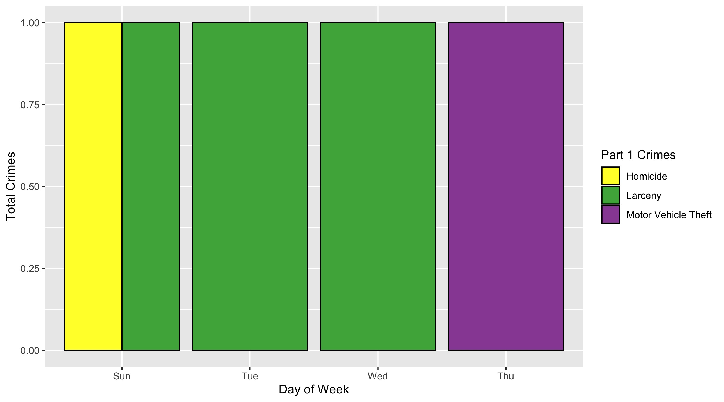
Lewis Place: Crimes by Day and Category

Slide 41
Vandeventer: Neighborhood Detail
Appendix 4

Slide 42
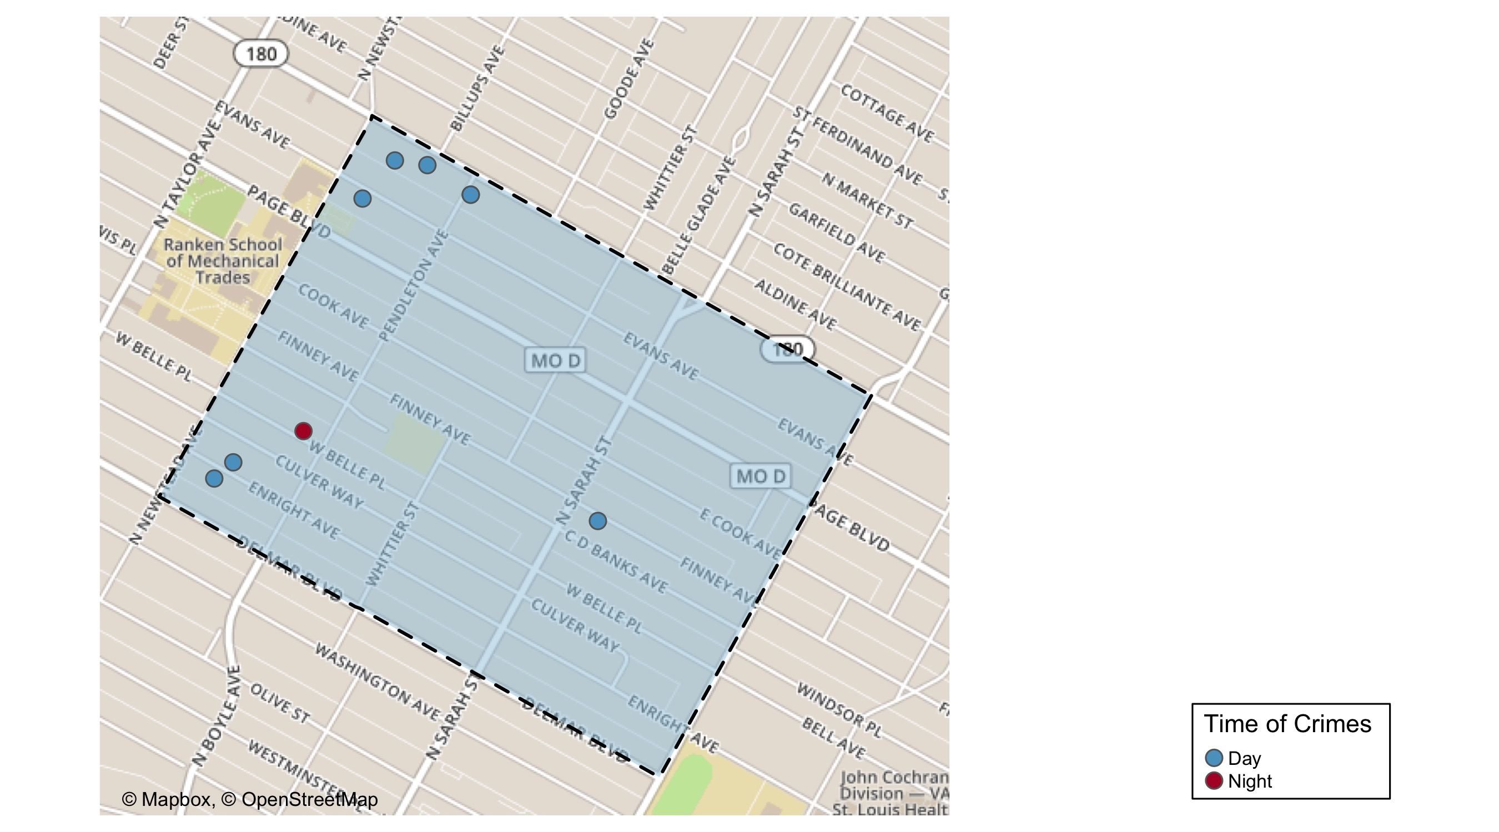
Vandeventer: Time of Crimes Map

Slide 43
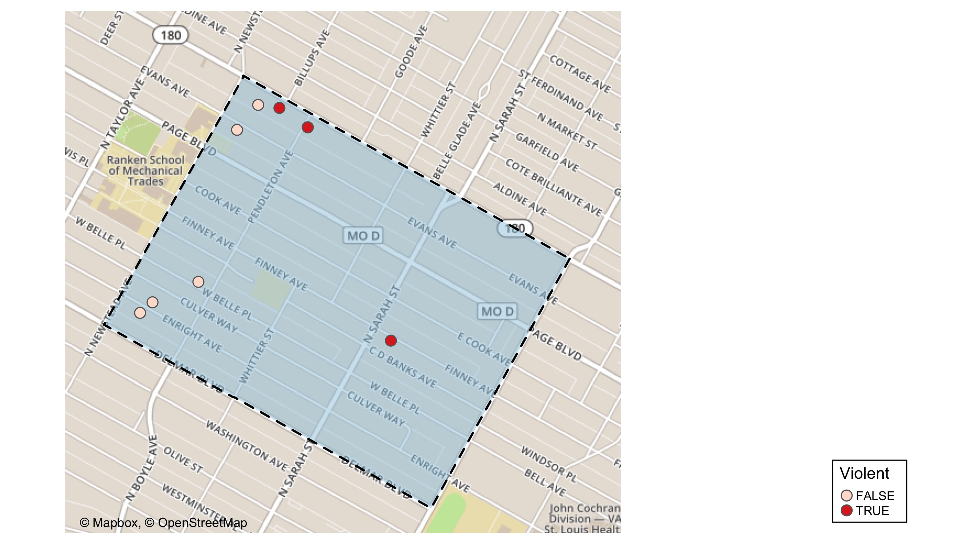
Vandeventer: Violent Crime Map

Slide 44
Vandeventer: Larceny Breakdown
Day of the Week | Number of Crimes
Wed | 1
Thu | 2
Sat | 1
Total | 4
Type of Larceny | Number of Crimes
From Motor Vehicle | 3
Shoplifting | 1
Total | 4
Time of Day | Number of Crimes
Day | 3
Night | 1
Total | 4
Monetary | Number of Crimes
Under $500 | 4
Total | 4

Slide 45
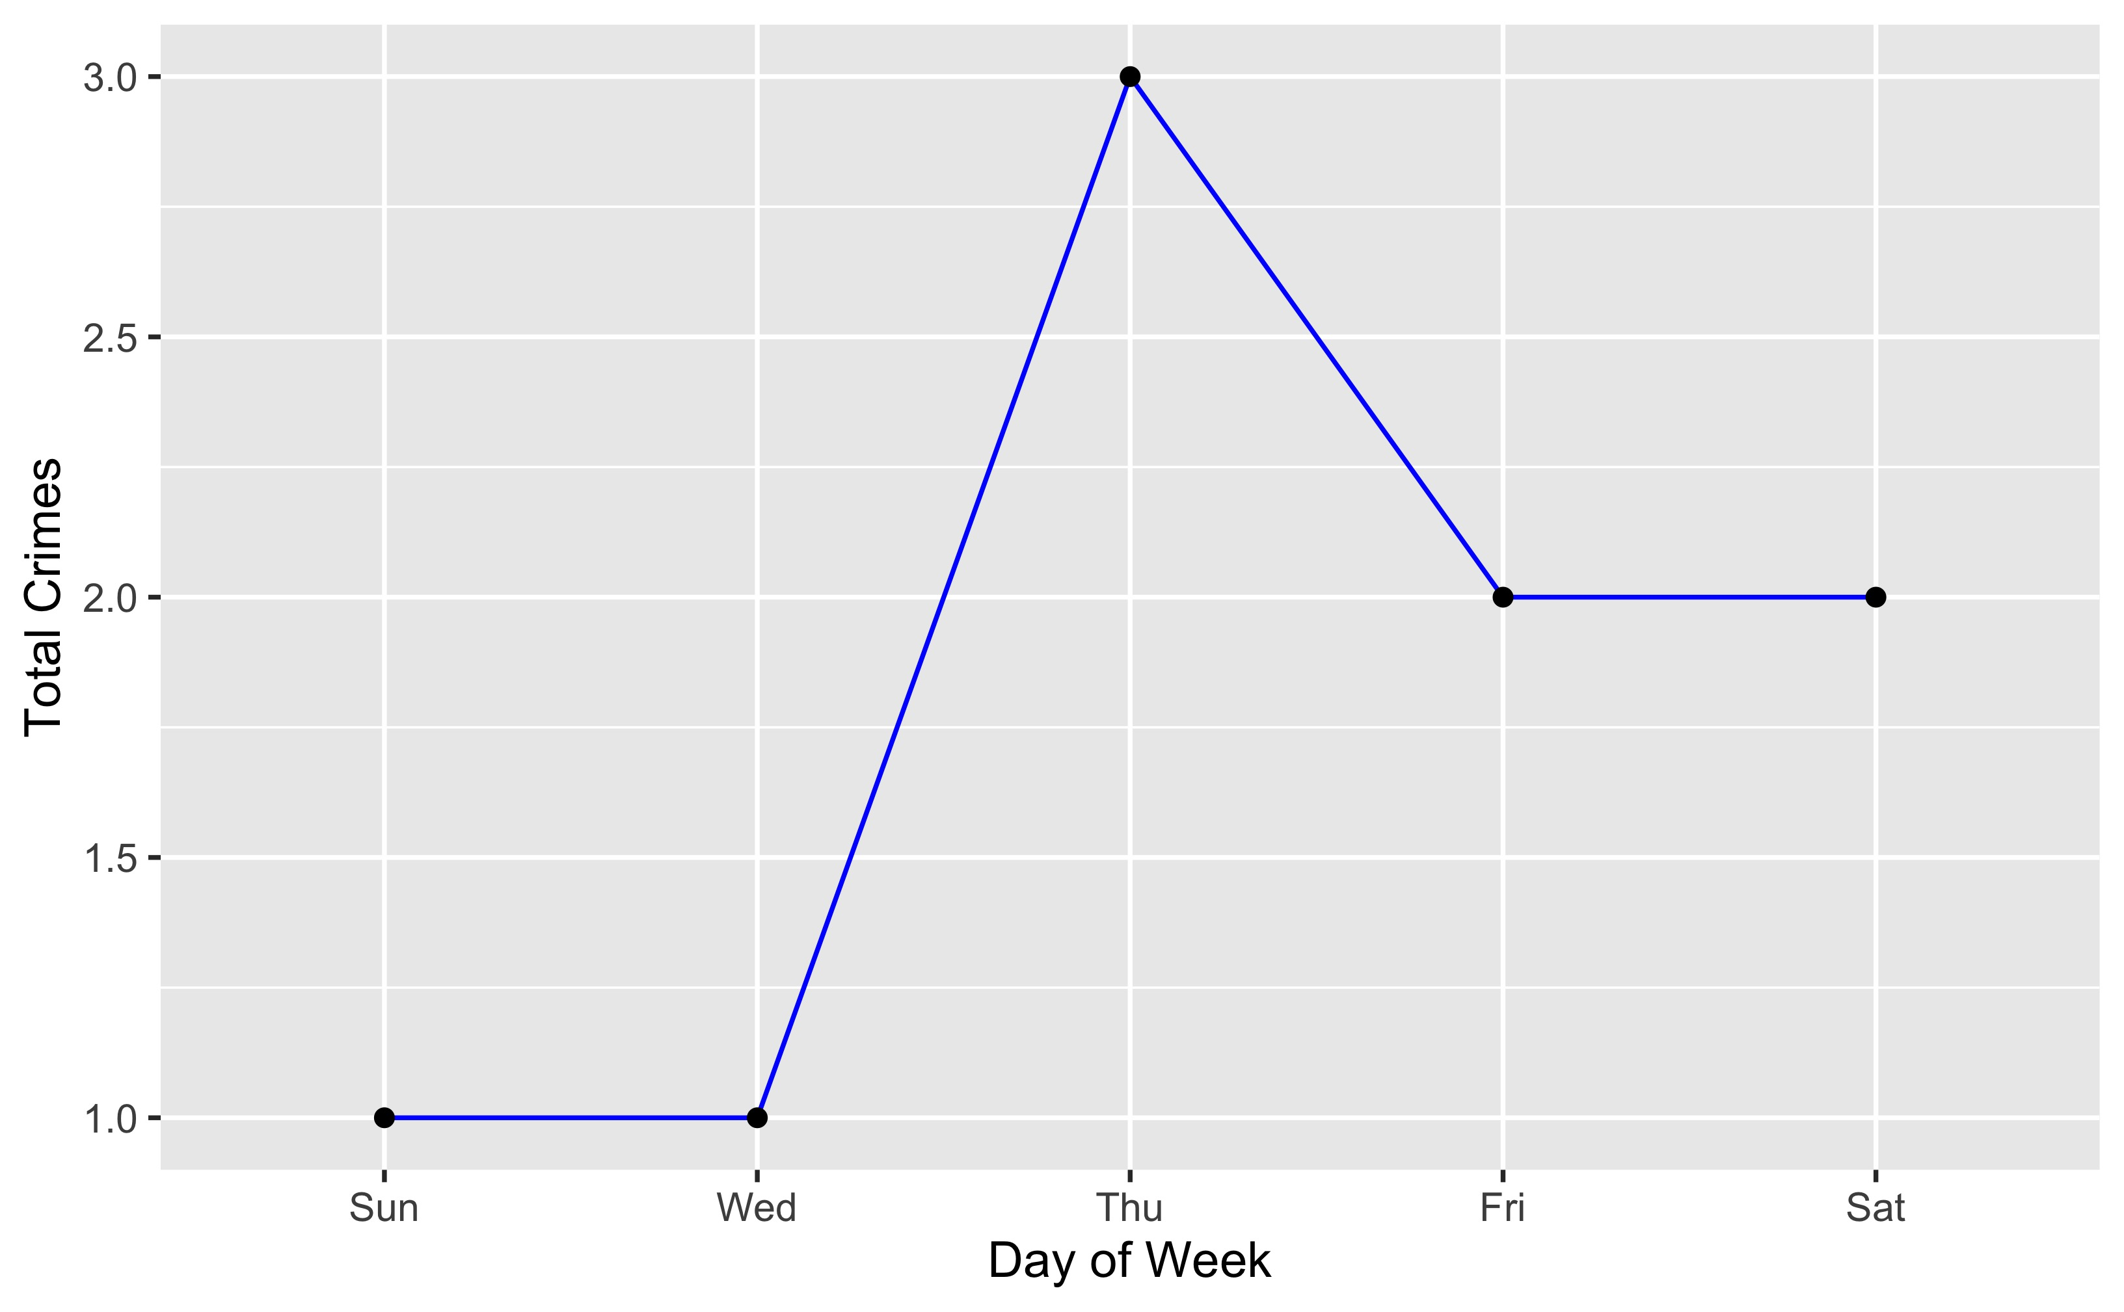
Vandeventer: Total Crimes by Days of the Week

Slide 46
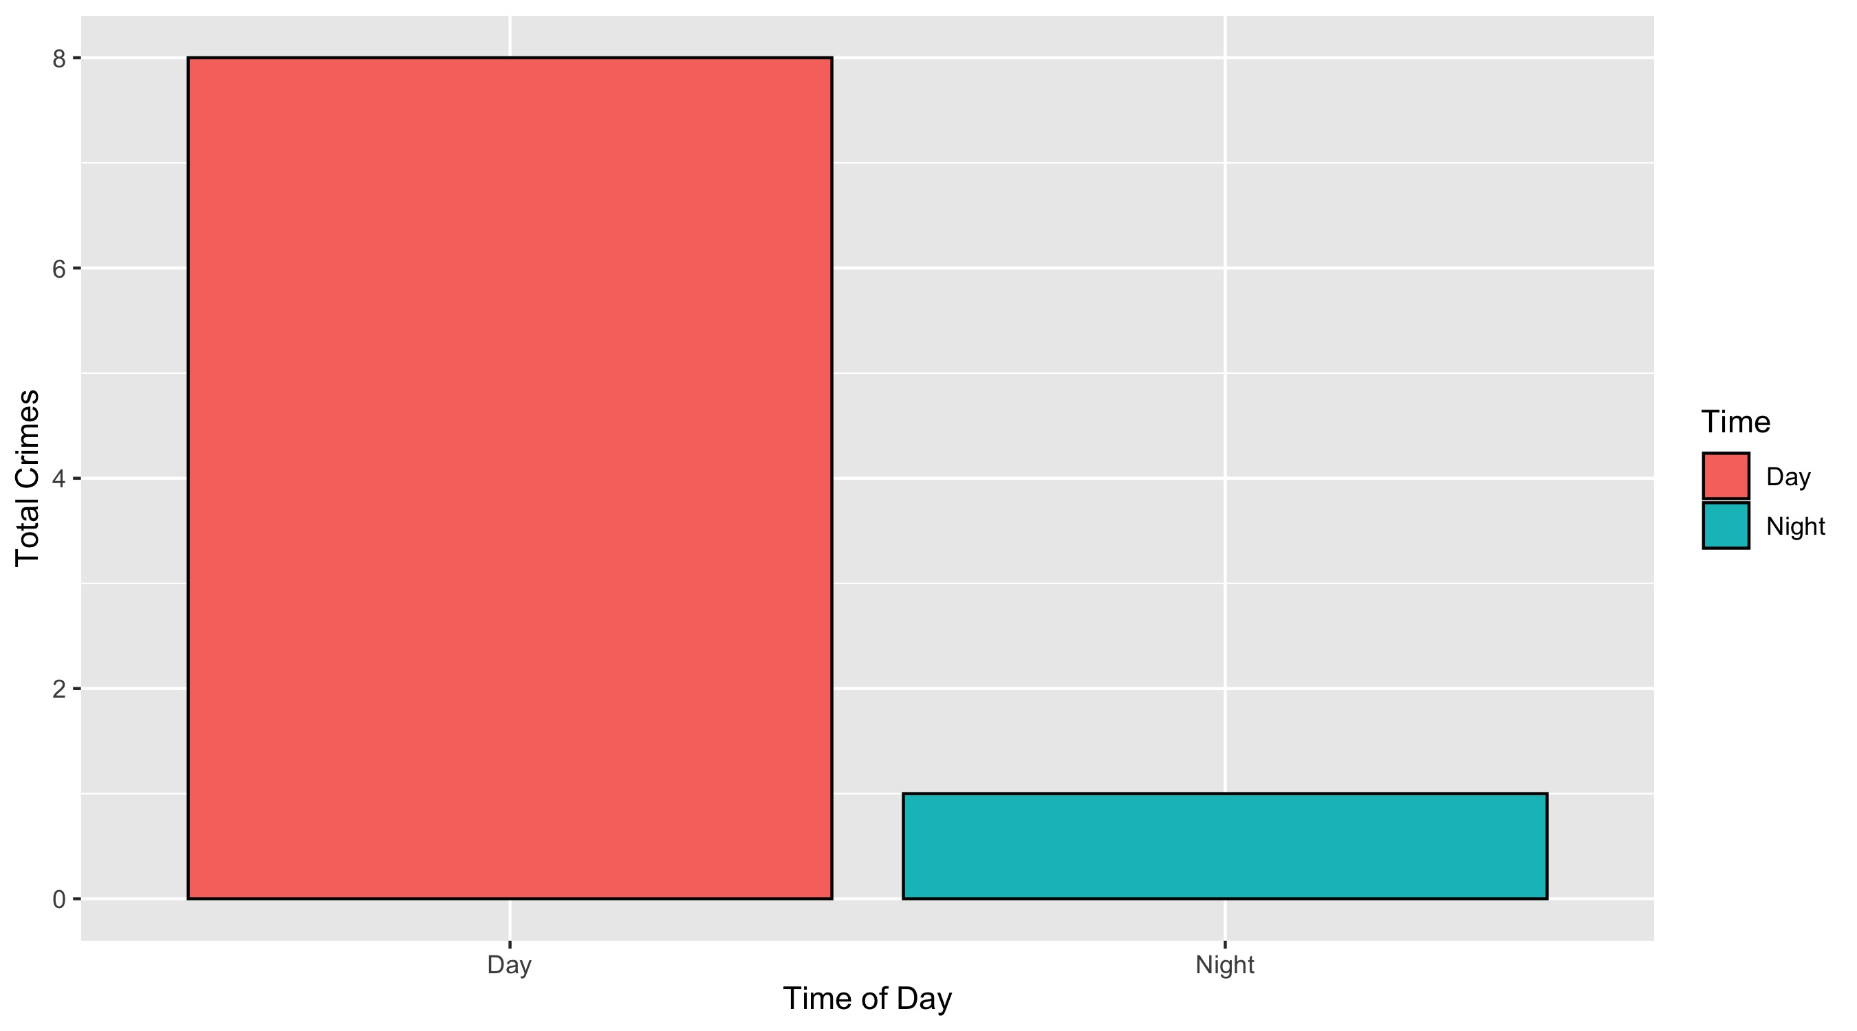
Vandeventer: Crimes by Time of Day

Slide 47
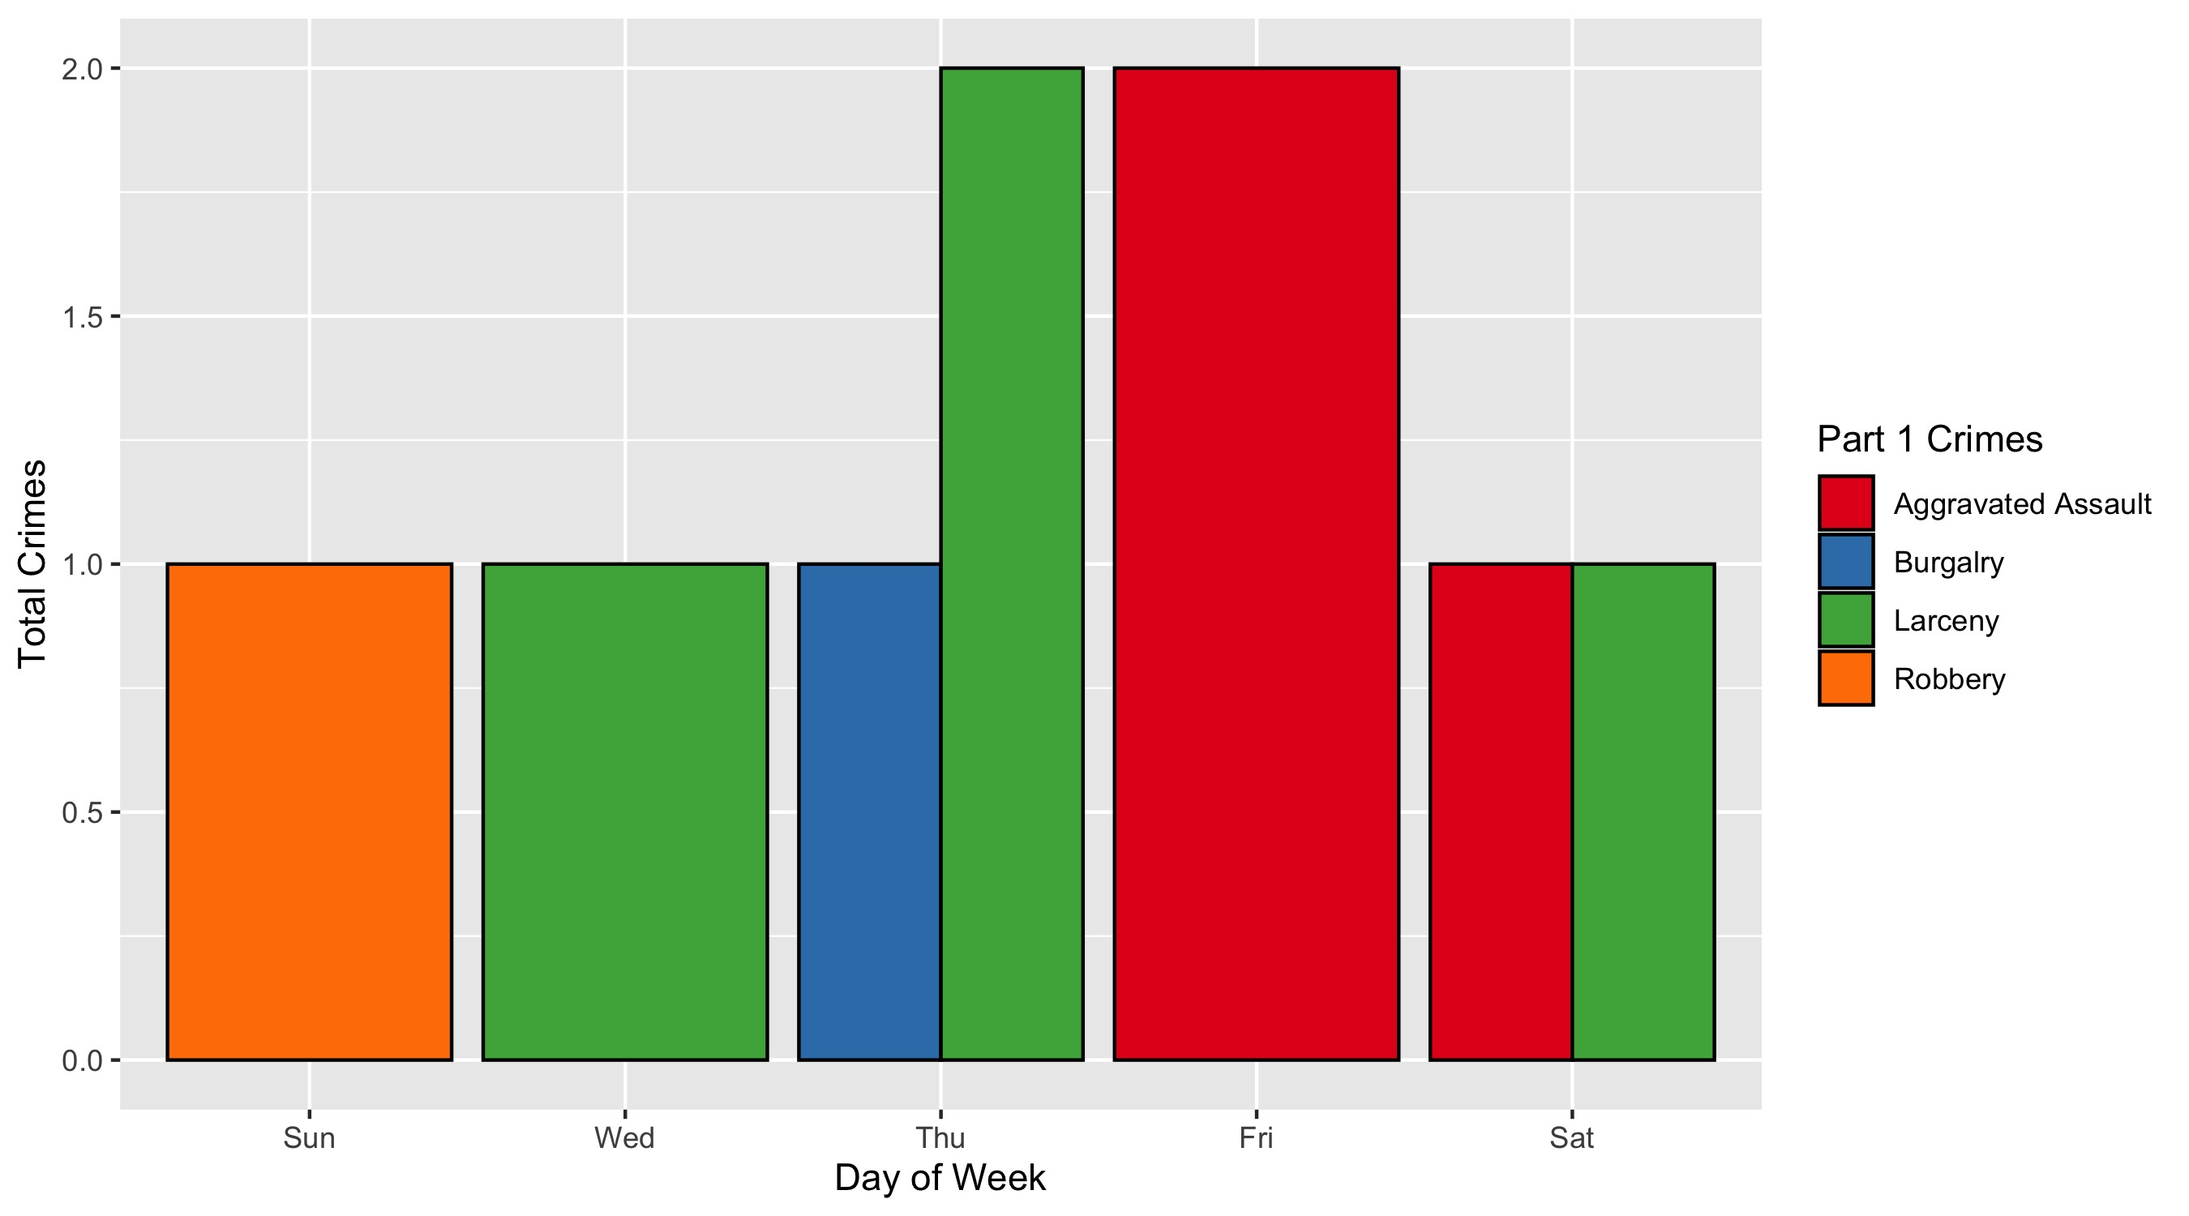
Vandeventer: Crimes by Day and Category

